Slide 1
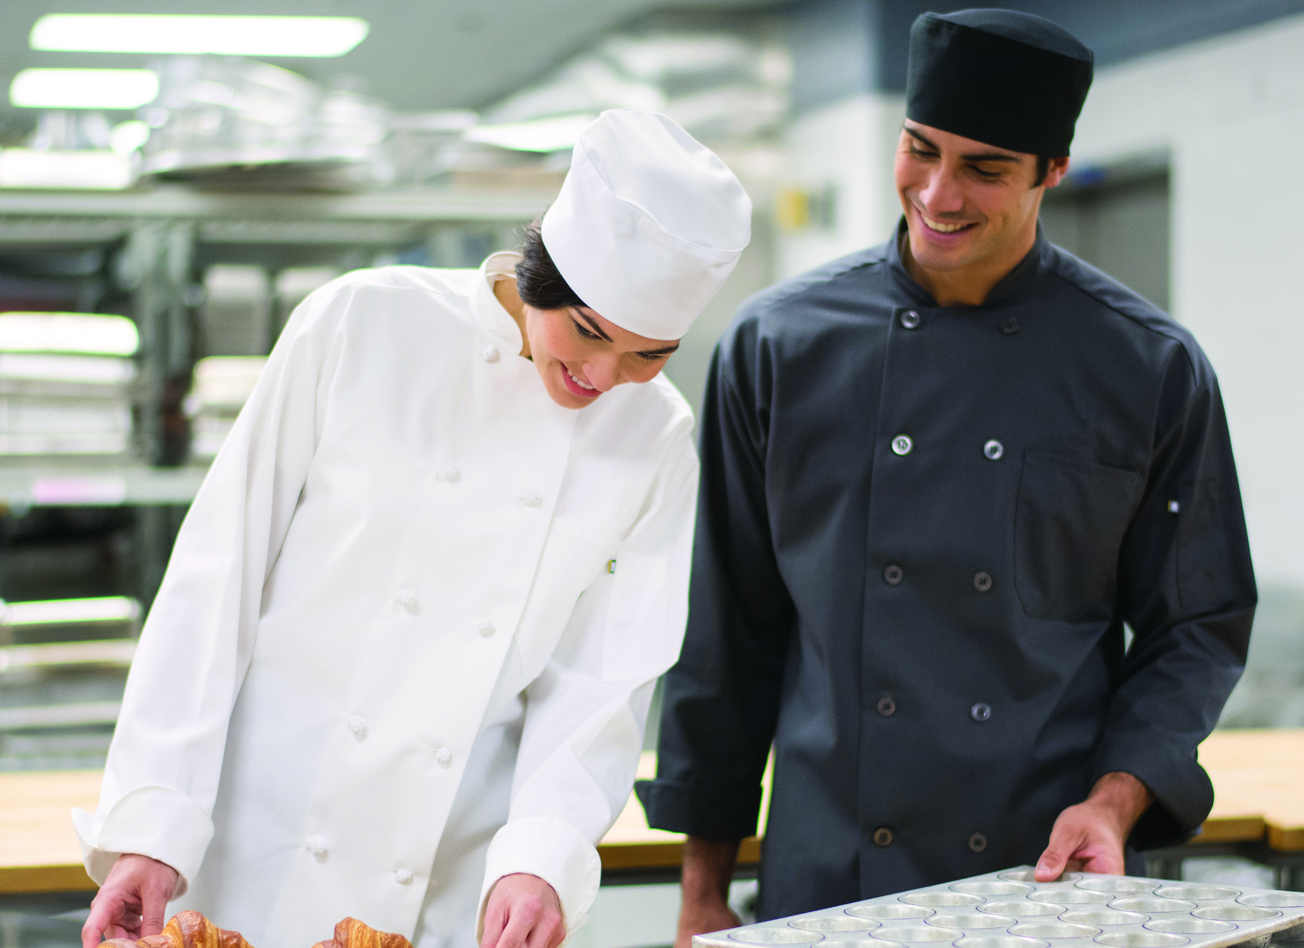
RESTAURANTS/DINING UNIFORMS

Slide 2
Host / Hostess
Edwards Ultimate Snag-Proof Polo #1512/1562/5512
Colors: White, Navy, Black, Red, Burgundy, Royal, Steel Grey, Silver Tan, Fern Green
Men’s Sizes: S-3XL, LT-6XLT | Ladies’ Sizes: XXS-4XL
Unisex Sizes: XXS-6XL
Edwards Flex Chino Pant #2583/8583
Colors: Black, Ash Grey, True Navy
Men’s Sizes: 28-54 | Ladies’ Sizes: 0-32

Slide 3
Host / Hostess
Edwards Stand-Up Collar Batiste Shirt #1398/5398
Colors: Black, Red, Burgundy, Purple, Steel Grey, Riviera Blue, Caribbean Blue, Cobalt, Platinum
Men’s Sizes: S-3XL, LT-6XLT | Ladies’ Sizes: XXS-4XL
Edwards Essential Pant #2793/8793
Colors: Black, Dark Navy, Steel Grey, Cobblestone
Men’s Sizes: 28-60 | Ladies’ Sizes: 00-32

Slide 4
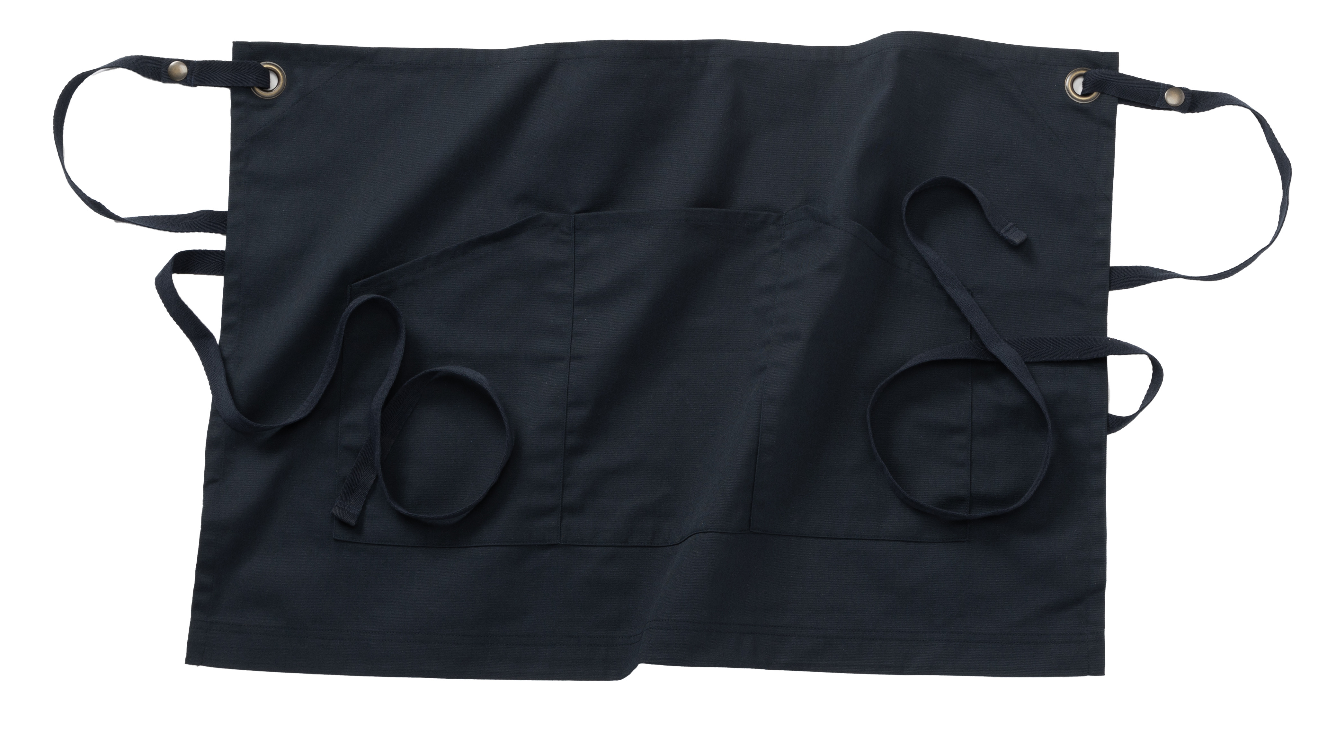
Waitstaff
Edwards Mini-Pique Snag-Proof Polo #1507/5507
Colors: White, Black, Red, Royal, French Blue, Steel Grey, Hi-Vis Lime, Hi-Vis Orange, Bright Navy, Cool Grey
Men’s Sizes: S-3XL, 4XLT-6XLT | Ladies’ Sizes: 00-28
Edwards Essential Pant #2793/8793
Colors: Black, Dark Navy, Steel Grey, Cobblestone
Men’s Sizes: 28-60 | Ladies’ Sizes: 00-32
Edwards Twill Waist Apron #9041
Colors: Navy, Black, Red, Royal
Size: 19”L x 28”W

Slide 5
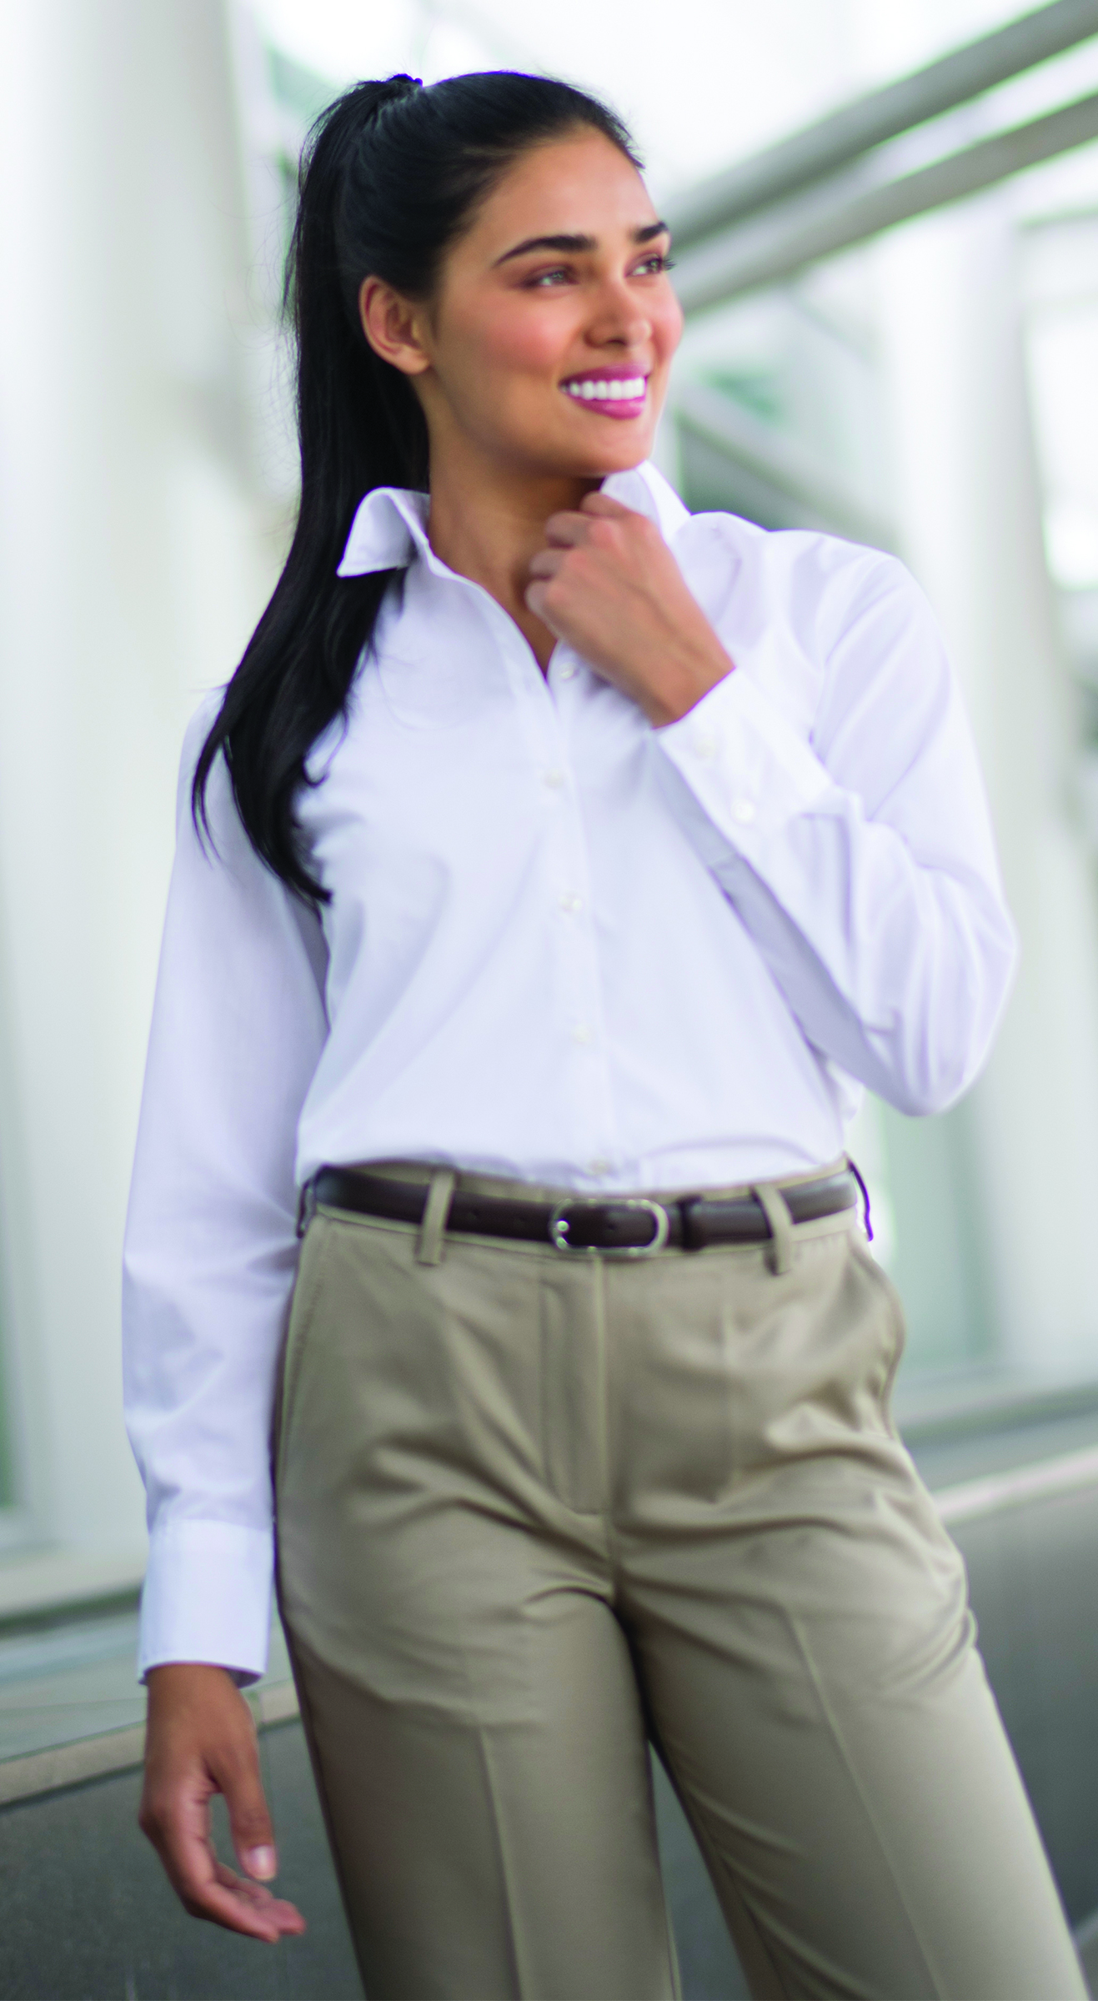
Waitstaff
Edwards Lightweight Poplin #1295/5040/5295
Colors: White, Blue, Tan, Navy, Black, Red, Burgundy, Royal, French Blue, Steel Grey, Hunter
Men’s Sizes: S-3XL, LT-6XLT | Ladies’ Sizes: XXS-4XL
Edwards Microfiber Pant #2534/8532
Colors: Tan, Navy, Black
Men’s Sizes: 28-60 | Ladies’ Sizes: 00-32

Slide 6
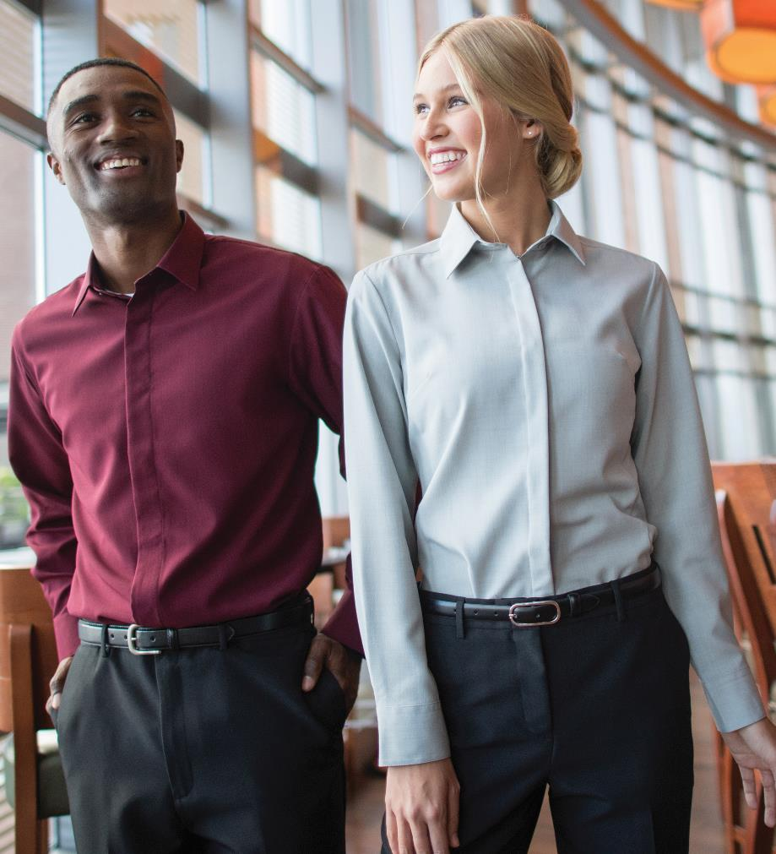
Waitstaff
Edwards Café Batiste Shirt #1291/5291
Colors: White, Black, Burgundy, Purple, Steel Grey, Riviera Blue, Caribbean Blue, Cobalt, Platinum
Men’s Sizes: S-3XL, LT-6XLT | Ladies’ Sizes: XXS-4XL
Edwards Flex Chino Pant
Color: Black, Ash Grey, True Navy
Men’s Sizes: 28-54 | Ladies’ Sizes: 0-32

Slide 7
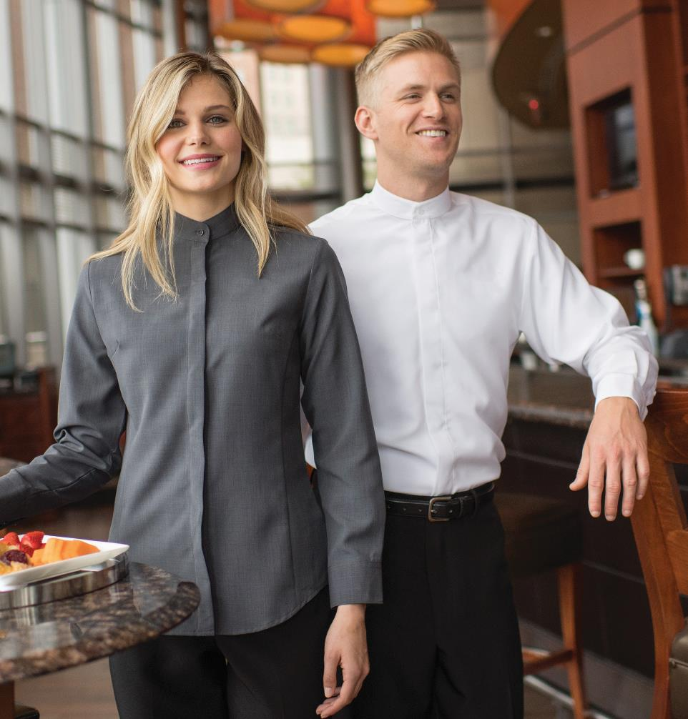
Bar / Server
Edwards Banded Collar Batiste Shirt #1392/5392
Colors: White, Black, Burgundy, Steel Grey, Riviera Blue
Men’s Sizes: S-3XL, LT-6XLT | Ladies’ Sizes: XXS-3XL
Edwards Flex Chino Pant 2583/8583
Color: Black, Ash Grey, True Navy
Men’s Sizes: 28-54 | Ladies’ Sizes: 0-32

Slide 8
Bar / Server
Edwards Café Broadcloth Shirt #1290/5290
Colors: White, Black, Royal
Men’s Sizes: S-3XL, MT-6XLT | Ladies’ Sizes: XXS-3XL
Edwards Ottoman Trim Vest #4398/7398
Colors: Black, Dark Navy, Steel Grey
Men’s Sizes: S-6XL| Ladies’ Sizes: XXS-4XL
Edwards Essential Pant #2793/8793
Colors: Black, Dark Navy, Steel Grey, Cobblestone
Men’s Sizes: 28-60 | Ladies’ Sizes: 00-32

Slide 9
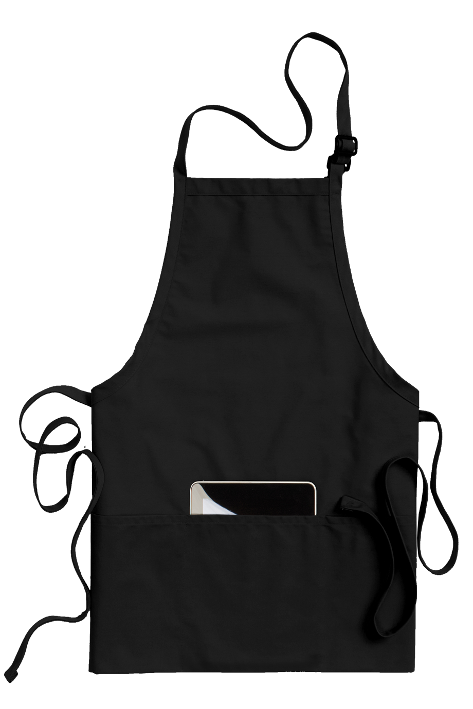
Bussing
Edwards Ultimate Lightweight Snag-Proof Polo #1522/5522
Colors: White, Navy, Black, Red, Royal, Steel Grey, Fern Green, Cool Grey
Men’s Sizes: S-3XL, LT-6XLT | Ladies’ Sizes: XXS-4XL
Edwards Slim Stretch Chino Pant #2555/8555
Colors: Tan, Black, Dark Navy, Steel Grey
Men’s Sizes: 28-42 | Ladies’ Sizes: 0-20
Edwards 3-Pocket Bib Apron #9002
Colors: White, Navy, Black, Red, Khaki, Royal, Wine, Steel Grey, Hunter
Size: 24”L x 28”W

Slide 10
Bussing
Edwards Food Service Polo #1586
Colors: Navy, Black, Steel Grey, Marina Blue
Unisex Sizes: XXS-3XL, 4XLT-6XLT
Edwards Utility Chino Short #2437/8435
Colors: Tan, Navy, Black, Coal
Men’s Sizes: 28-60 | Ladies’ Sizes: 00-32
Edwards Utility Chino Pant #2537/8537
Colors: Tan, Navy, Black, Coal
Men’s Sizes: 28-60 | Ladies’ Sizes: 00-32

Slide 11
Management
Edwards Sustainable Shirt #1996/5296
Colors: Black, Eggplant, Titanium
Men’s Sizes: S-3XL, LT-6XLT | Ladies’ Sizes: XXS-4XL
Edwards Synergy Dress Pant & Skirt #2525/2535/8525/8526/8535/9725
Colors: Navy, Black, Steel Grey
Men’s Sizes: 28-60 | Ladies’ Sizes: 00-32

Slide 12
Management
Edwards Synergy Suit Coat #3525/6575
Colors: Navy, Black, Steel Grey
Men’s Sizes: 36-62 (S, R, L) | Ladies’ Sizes: 0-28 (R, T)
Edwards Pinpoint Oxford #1978/5980
Colors: White, Light Blue, Charcoal, French Blue, Silver, Blue/White Stripe
Men’s Sizes: S-3XL, LT-6XLT | Ladies’ Sizes: XXS-4XL
Edwards Synergy Dress Pant & Skirt #2525/2535/8525/8526/8535/9725
Colors: Navy, Black, Steel Grey
Men’s Sizes: 28-60 | Ladies’ Sizes: 00-32

Slide 13
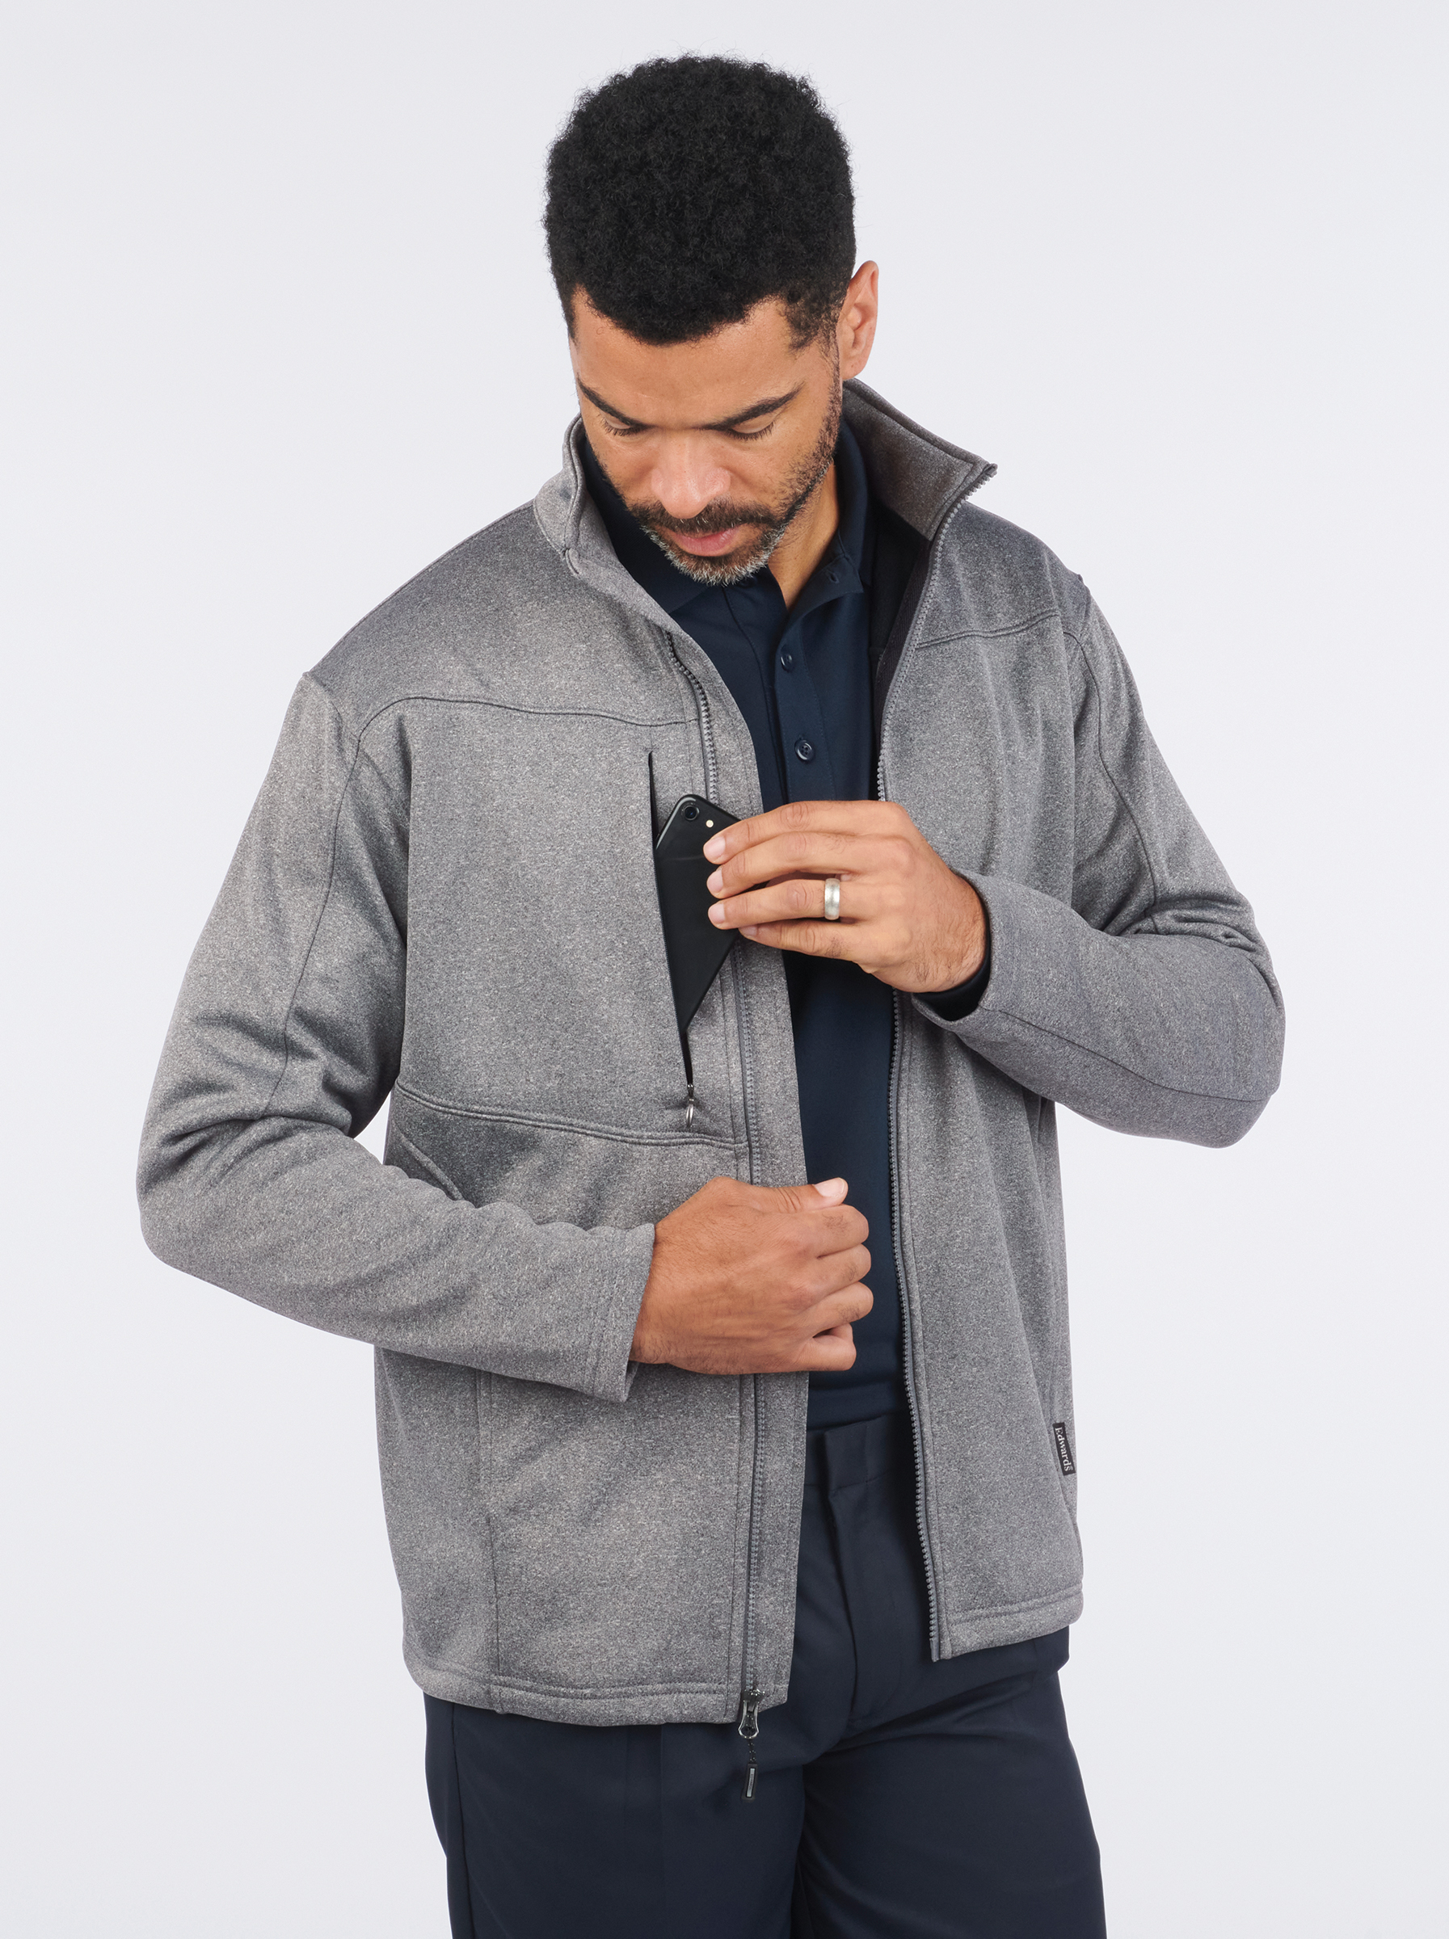
Valet/Parking
Edwards Performance Tek Jacket #3440/6440
Colors: Navy, Black, Grey Heather
Men’s Sizes: S-6XL | Ladies’ Sizes: XS-4XL
Edwards Batiste Shirt #1292/5292/5293
Colors: White, Black, Steel Grey, Riviera Blue, Platinum
Men’s Sizes: S-3XL, LT-6XLT | Ladies’ Sizes: XXS-4XL
Edwards Microfiber Pant #2534/8532
Colors: Tan, Navy, Black
Men’s Sizes: 28-60 | Ladies’ Sizes: 00-32

Slide 14
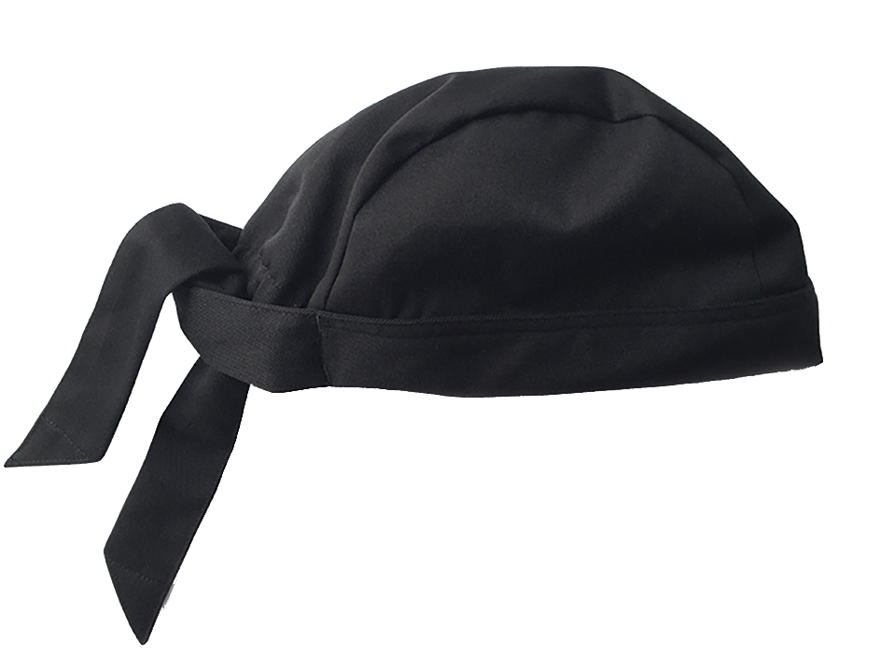
Culinary / Kitchen
Edwards Cook Shirt #1303
Color: Black
Unisex Sizes: XS-6XL
Edwards Basic Chef Pant #2000
Colors: Black, Black Stripe
Unisex Sizes: XS-6XL
Edwards Skull Cap #HT01
Colors: Black
One Size Fits Most

Slide 15
Culinary / Kitchen
Edwards Classic Chef Coat #3301
Colors: White, Black
Unisex Sizes: XS-6XL
Edwards Cargo Chef Pant #2003
Color: Black
Unisex Sizes: XS-6XL
Edwards Beanie with Elastic Back #HT02
Colors: White, Black
One Size Fits Most

Slide 16
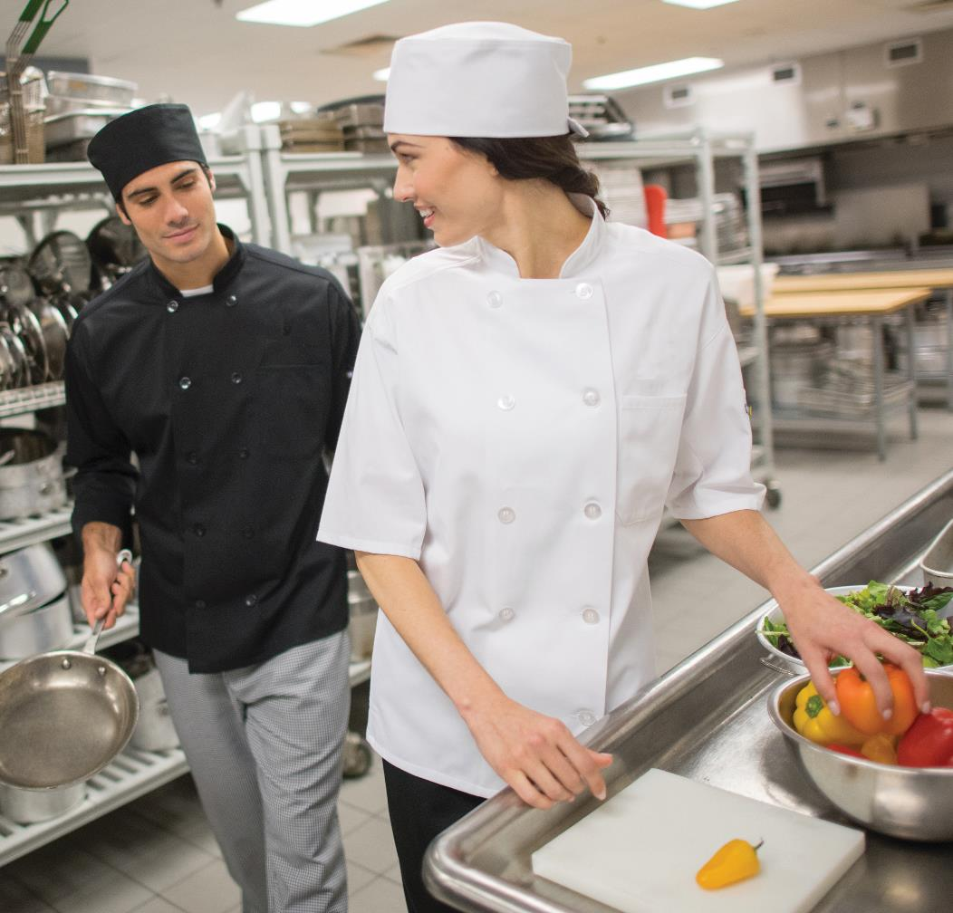
Culinary / Kitchen
Edwards Mesh Back Chef Coat #3333
Colors: White, Black
Unisex Sizes: XS-6XL
Edwards Mesh Back Chef Coat #3363
Colors: White, Black
Unisex Sizes: XS-6XL
Edwards Cargo Chef Pant #2003
Color: Black
Unisex Sizes: XS-6XL

