Slide 1
HOTEL UNIFORMS Front-to-Back of House

Slide 2
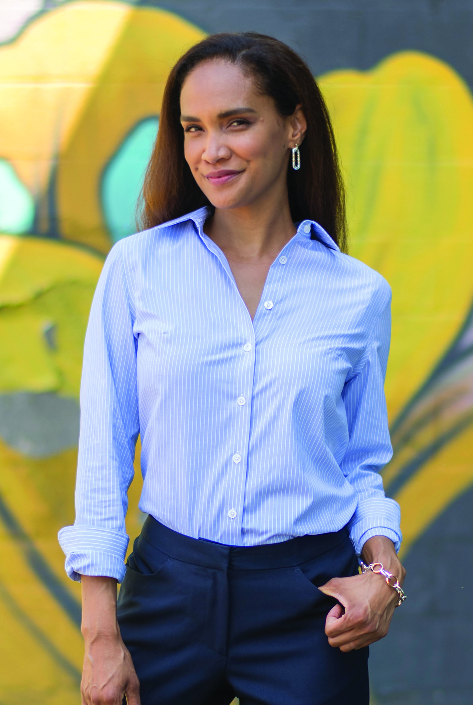
Valet/Parking
Edwards Essential Hopsack Blazer #3505/6505
Colors: Black, True Navy
Men’s Sizes: 34-58 (R, L) | Ladies’ Sizes: 0-32
Edwards Essential Pant #2793/8793
Colors: Black, Dark Navy, Steel Grey, Cobblestone
Men’s Sizes: 28-60 | Ladies’ Sizes: 00-32
Edwards Pinpoint Oxford #1978/5980
Colors: White, Light Blue, Charcoal, French Blue, Silver, Blue/White Stripe
Men’s Sizes: S-3XL, LT-6XLT | Ladies’ Sizes: XXS-4XL

Slide 3
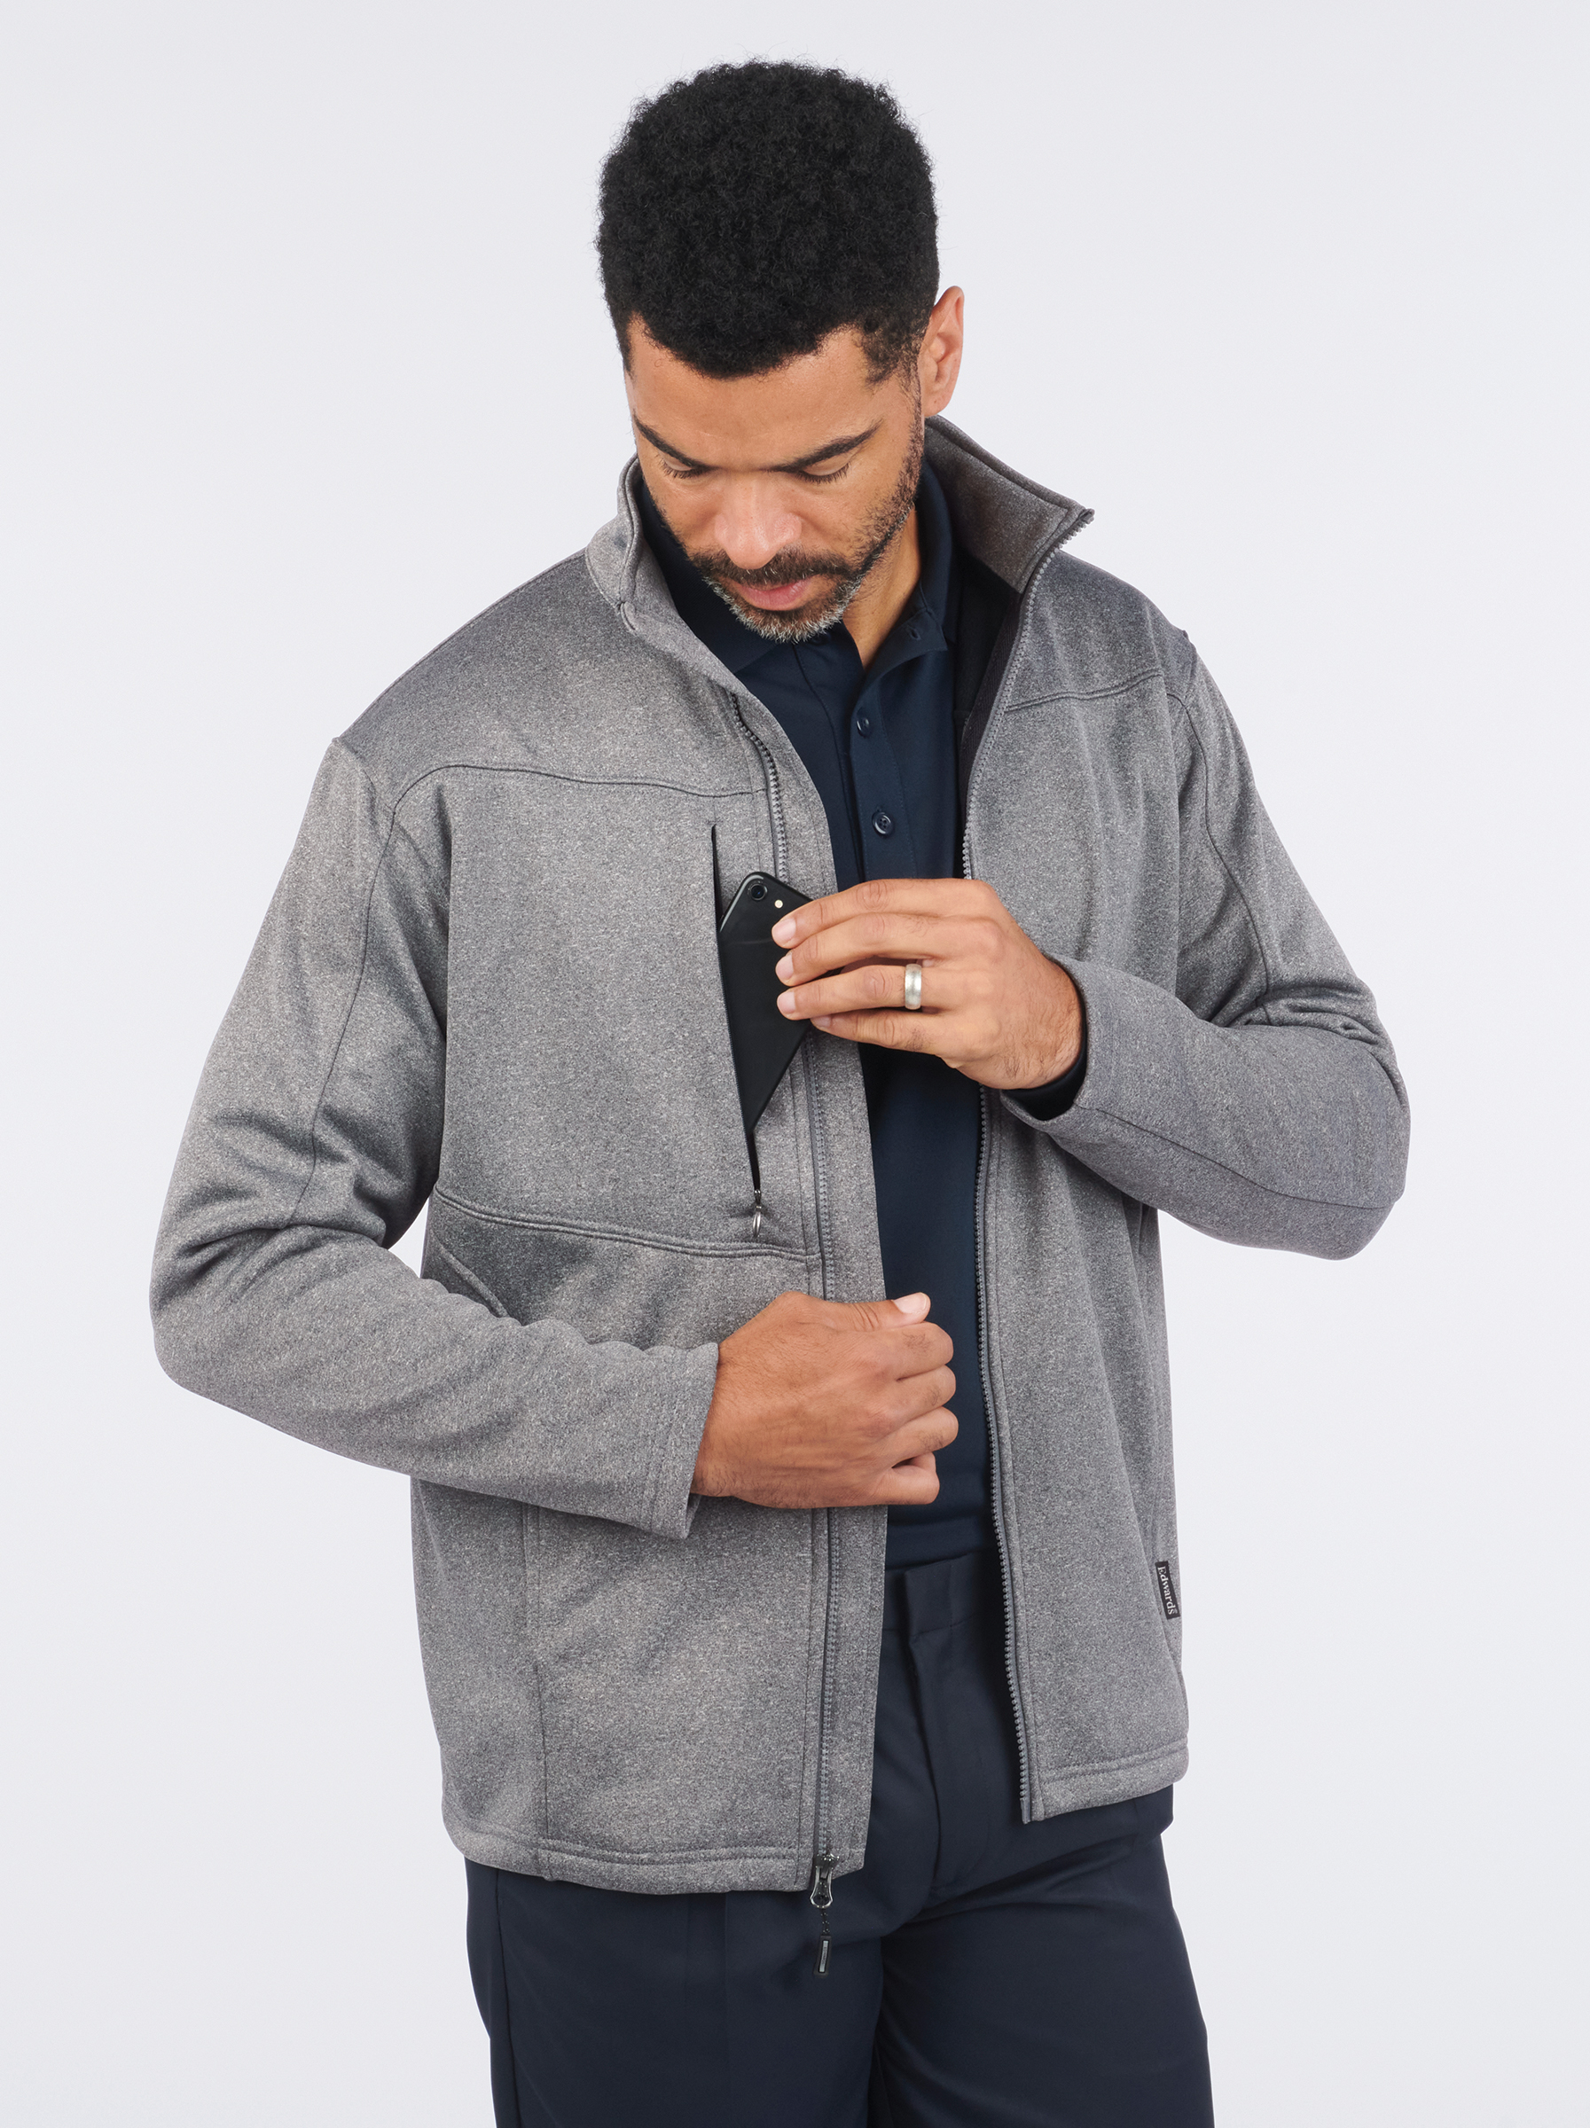
Valet/Parking
Edwards Performance Tek Jacket #3440/6440
Colors: Navy, Black, Grey Heather
Men’s Sizes: S-6XL | Ladies’ Sizes: XS-4XL
Edwards Batiste Shirt #1292/5292/5293
Colors: White, Black, Steel Grey, Platinum
Men’s Sizes: S-3XL, LT-6XLT | Ladies’ Sizes: XXS-4XL
Edwards Flex Chino Pant #2583/8583
Colors: Black, Ash Grey, True Navy
Men’s Sizes: 28-54 | Ladies’ Sizes: 0-32

Slide 4
Front Desk
Edwards Synergy Suit Coat #3525/6525/6575
Colors: Navy, Black, Steel Grey
Men’s Sizes: 36-62 (S, R, L) | Ladies’ Sizes: 00-28 (R, T)
Edwards Synergy Dress Pant & Skirt #2525/2535/8525/8526/8535/9725
Colors: Navy, Black, Steel Grey
Men’s Sizes: 28-60 | Ladies’ Sizes: 00-32
Edwards Pinpoint Oxford #1978/5980
Colors: White, Light Blue, Charcoal, French Blue, Silver, Blue/White Stripe
Men’s Sizes: S-3XL, LT-6XLT | Ladies’ Sizes: XXS-4XL

Slide 5
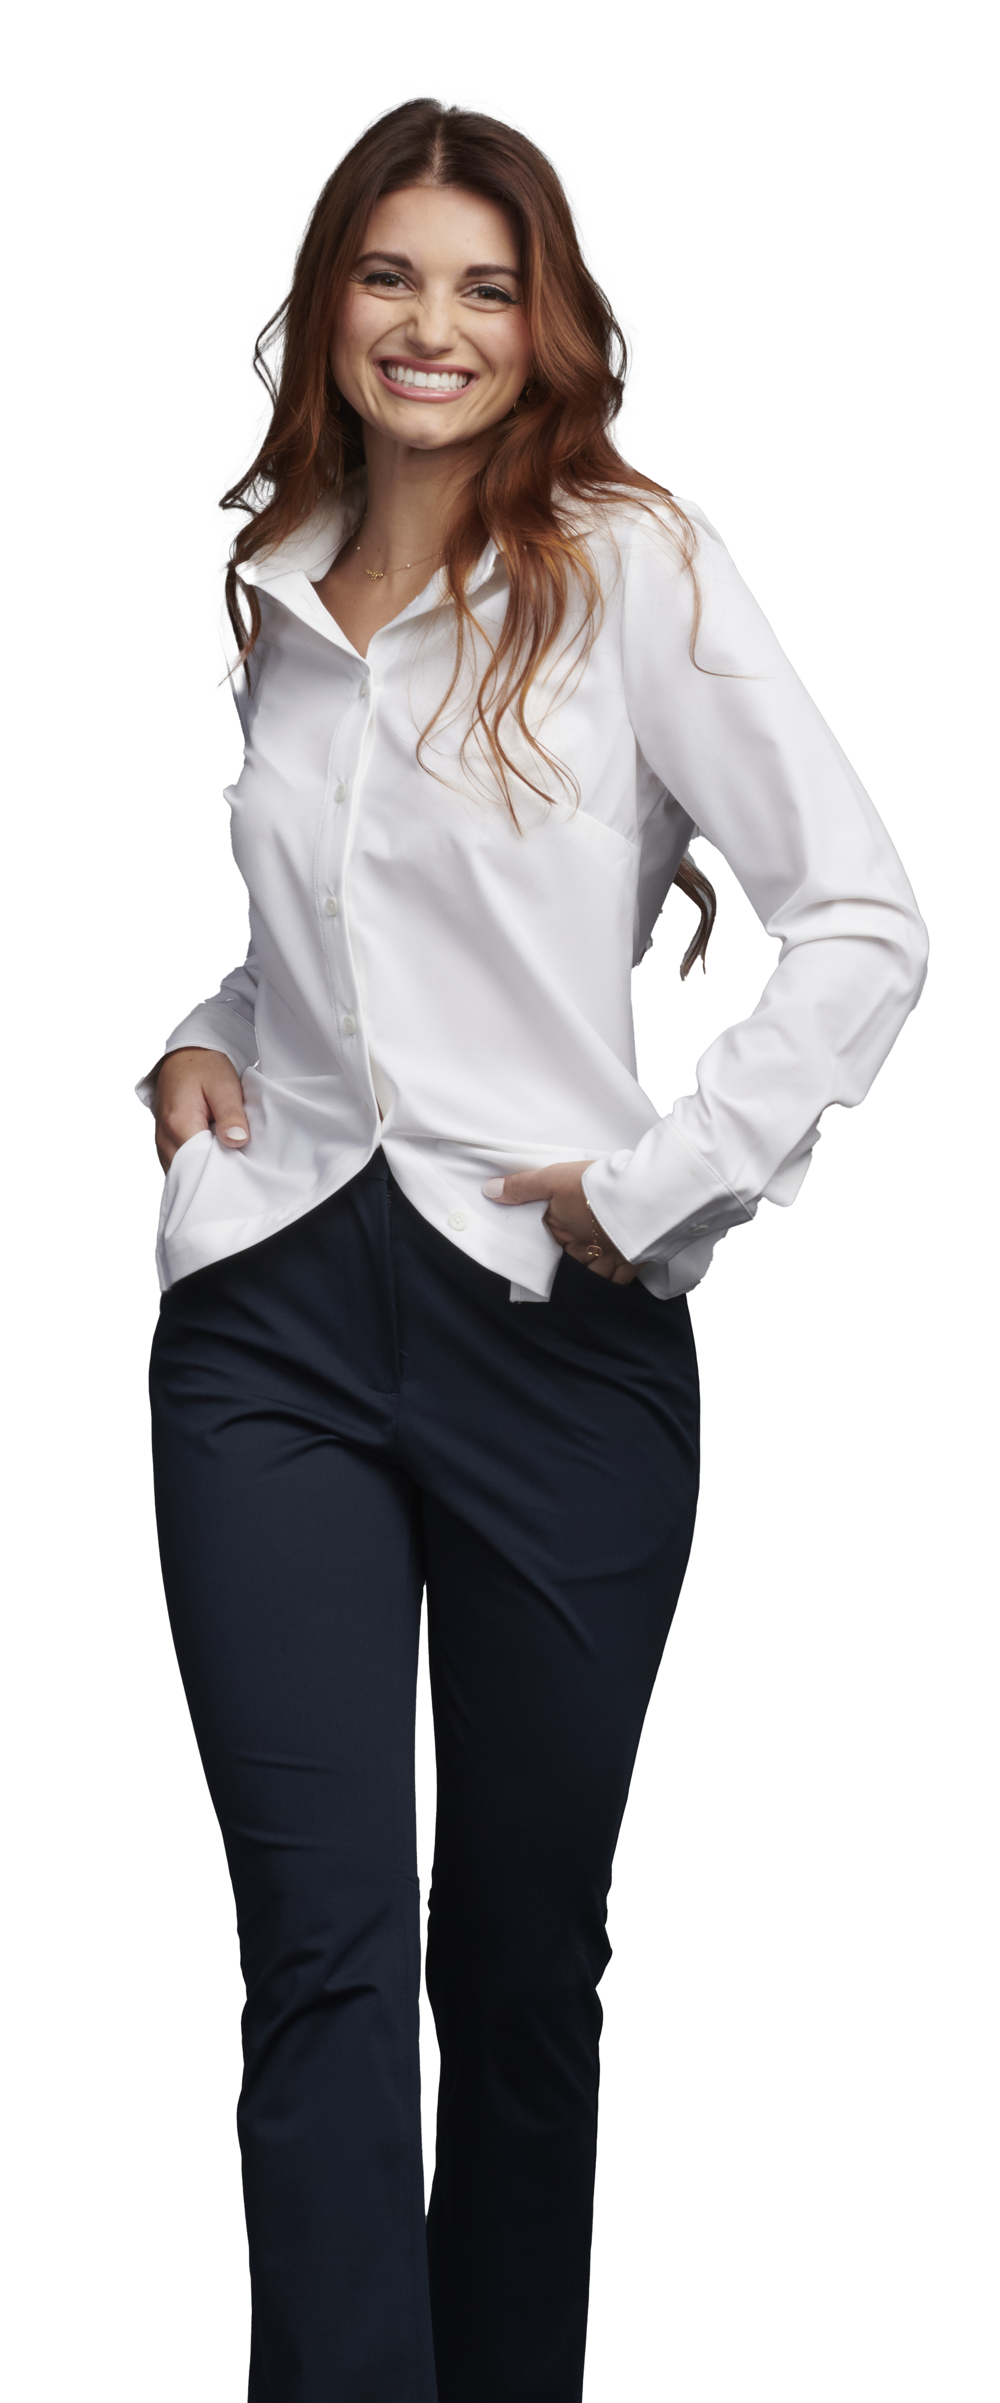
Management
Point Grey Blazers #3572/6572
Colors: Black, Forged Iron, Navy Agate
Men’s Sizes: S-4XL | Ladies’ Sizes: XS-3XL
Point Grey Pants #2572/8577
Colors: Black, Forged Iron, Navy Agate
Men’s Sizes: 28-54 (inseams 30”, 32”, 34”) | Ladies’ Sizes: 0-28 (inseams 28”, 30”, 32”)
Point Grey Shirts #1972/5272
Colors: White, Black, Forged Iron, Navy Agate
Men’s Sizes: S-3XL, MT-4XLT | Ladies’ Sizes: XXS-3XL

Slide 6
Management
Edwards Pinpoint Oxford #1978/5980
Colors: White, Light Blue, Charcoal, French Blue, Silver, Blue/White Stripe
Men’s Sizes: S-3XL, LT-6XLT | Ladies’ Sizes: XXS-4XL
Edwards Synergy Dress Pant & Skirt #2525/2535/8525/8526/8535/9725
Colors: Navy, Black, Steel Grey
Men’s Sizes: 28-60 | Ladies’ Sizes: 00-32

Slide 7
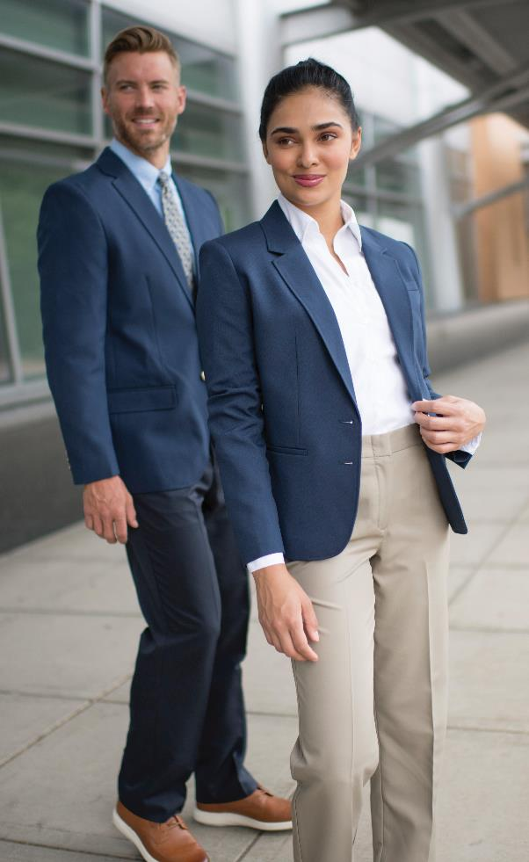
Concierge
Edwards Essential Hopsack Washable Blazer #3505/6505
Colors: Black, True Navy
Men’s Sizes: 34-58 (R, L)| Ladies’ Sizes: 0-32 (R, T)
Edwards Lightweight Poplin #1295/5295/5040
Colors: White, Blue, Tan, Navy, Black, Red, Burgundy, Royal, French Blue, Steel Grey, Hunter
Men’s Sizes: S-3XL, LT-6XLT | Ladies’ Sizes: XXS-4XL
Edwards Microfiber Pant #2534/2634/8532
Colors: Tan, Navy, Black
Men’s Sizes: 28-60 | Ladies’ Sizes: 00-32

Slide 8
Food & Beverage
Edwards Café Batiste Shirt #1291/5291
Colors: White, Black, Burgundy, Purple, Steel Grey, Riviera Blue, Caribbean Blue, Cobalt, Platinum
Men’s Sizes: S-3XL, LT-6XLT | Ladies’ Sizes: XXS-4XL
Edwards Essential Pant #2793/8793
Colors: Black, Dark Navy, Steel Grey, Cobblestone
Men’s Sizes: 28-60 | Ladies’ Sizes: 00-32

Slide 9
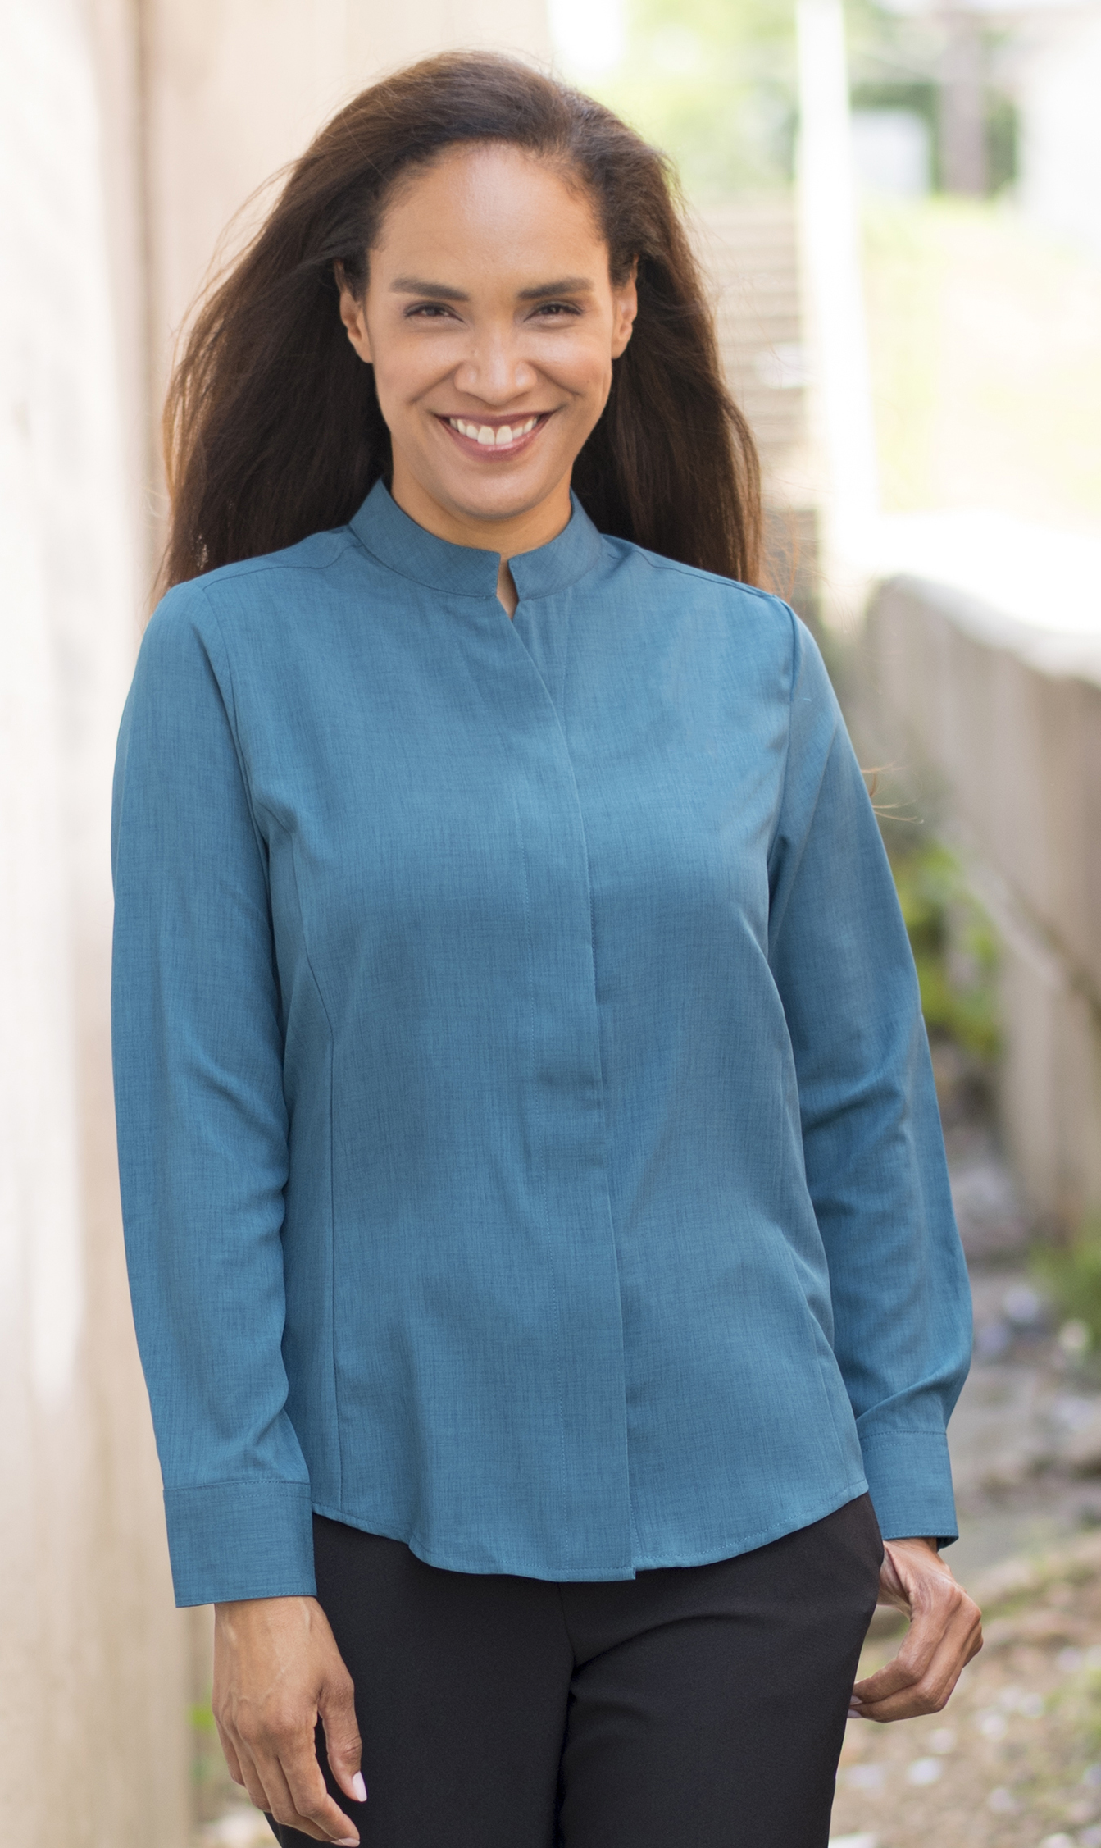
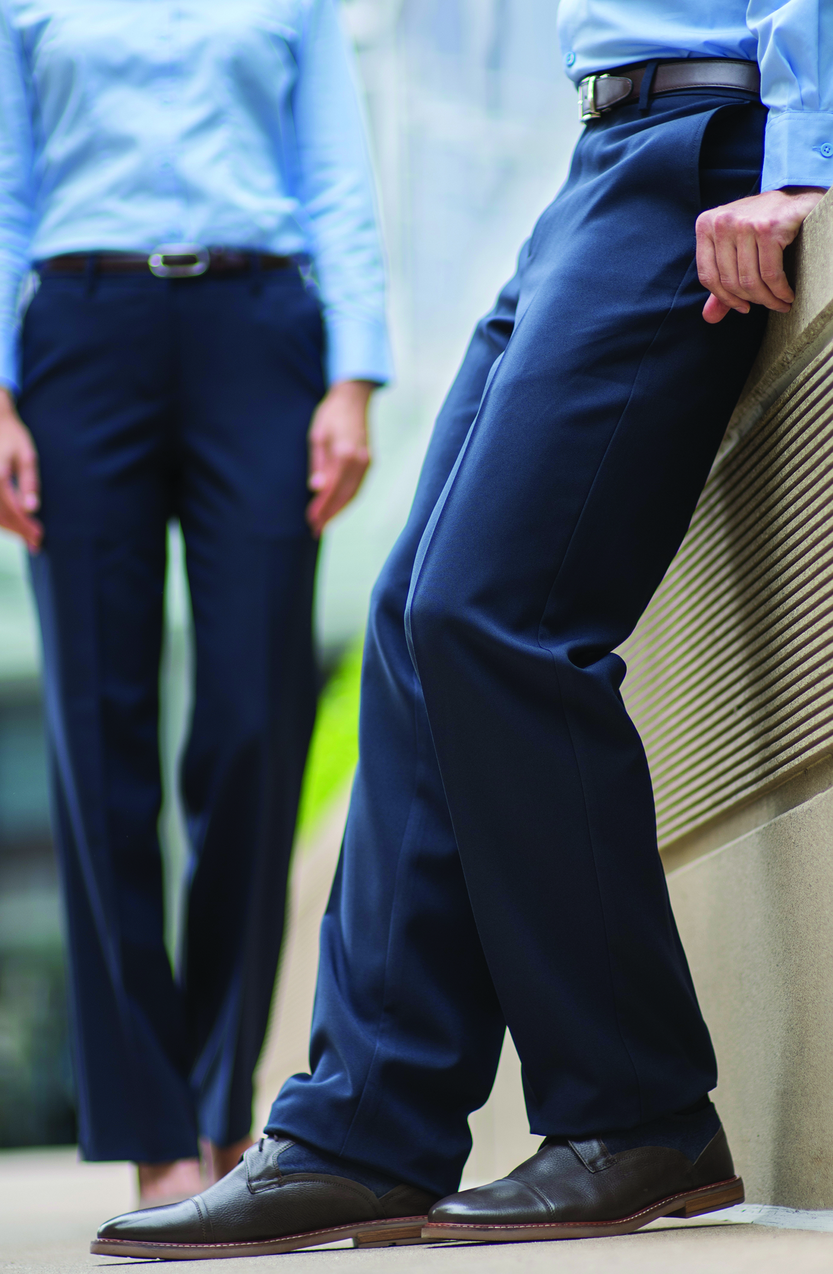
Food & Beverage
Edwards Stand-Up Collar Batiste Shirt #1398/5398
Colors: Black, Red, Burgundy, Purple, Steel Grey, Riviera Blue, Caribbean Blue, Cobalt, Platinum
Men’s Sizes: S-3XL, LT-6XLT | Ladies’ Sizes: XXS-4XL
Edwards Essential Pant #2793/8793
Colors: Black, Dark Navy, Steel Grey, Cobblestone
Men’s Sizes: 28-60 | Ladies’ Sizes: 00-32

Slide 10
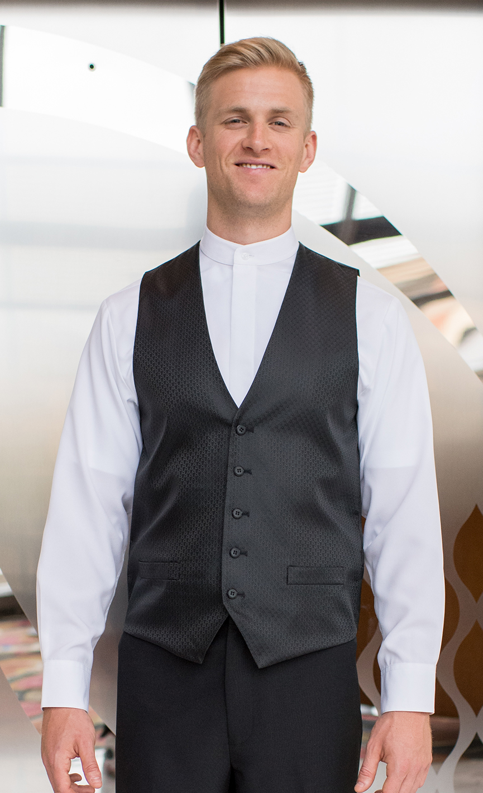
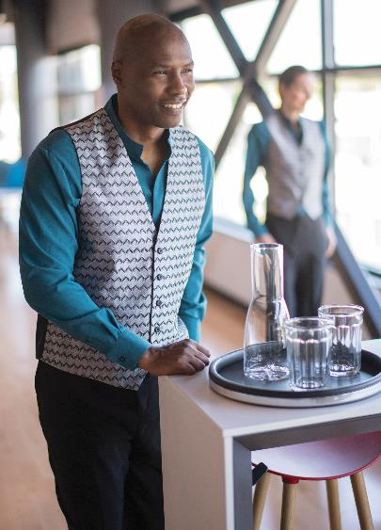
Food & Beverage
Edwards Diamond Brocade Vest #4390/7390
Colors: Black
Men’s Sizes: S-5XL | Ladies’ Sizes: XS-3XL
Edwards Ottoman Trim Vest #4398/7398
Color: Black, Dark Navy, Steel Grey
Men’s Sizes: S-6XL | Ladies’ Sizes: XXS-4XL
Edwards Swirl Brocade Vest #4391/7391
Colors: Black, Silver
Men’s Sizes: S-5XL | Ladies’ Sizes: XS-3XL

Slide 11
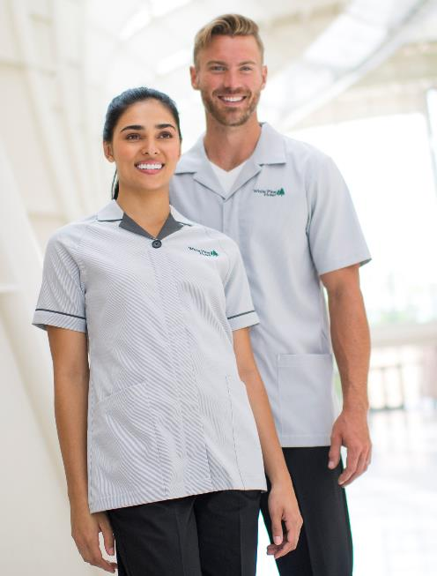
Housekeeping
Edwards Pincord Ultra-Stretch Service Shirt/Tunic #4282/7277
Colors: Steel Grey Pincord, Navy Peony Pincord
Men’s Sizes: S-4XL | Ladies’ Sizes: XXS-4XL
Edwards Melange Ultra-Light Chambray Shirt/Tunic #4281/7279
Colors: Burgundy Heather, Black Heather
Men’s Sizes: S-4XL | Ladies’ Sizes: XXS-4XL
Edwards Essential Pant #2793/8793
Colors: Black, Dark Navy, Steel Grey, Cobblestone
Men’s Sizes: 28-60 | Ladies’ Sizes: 00-32

Slide 12
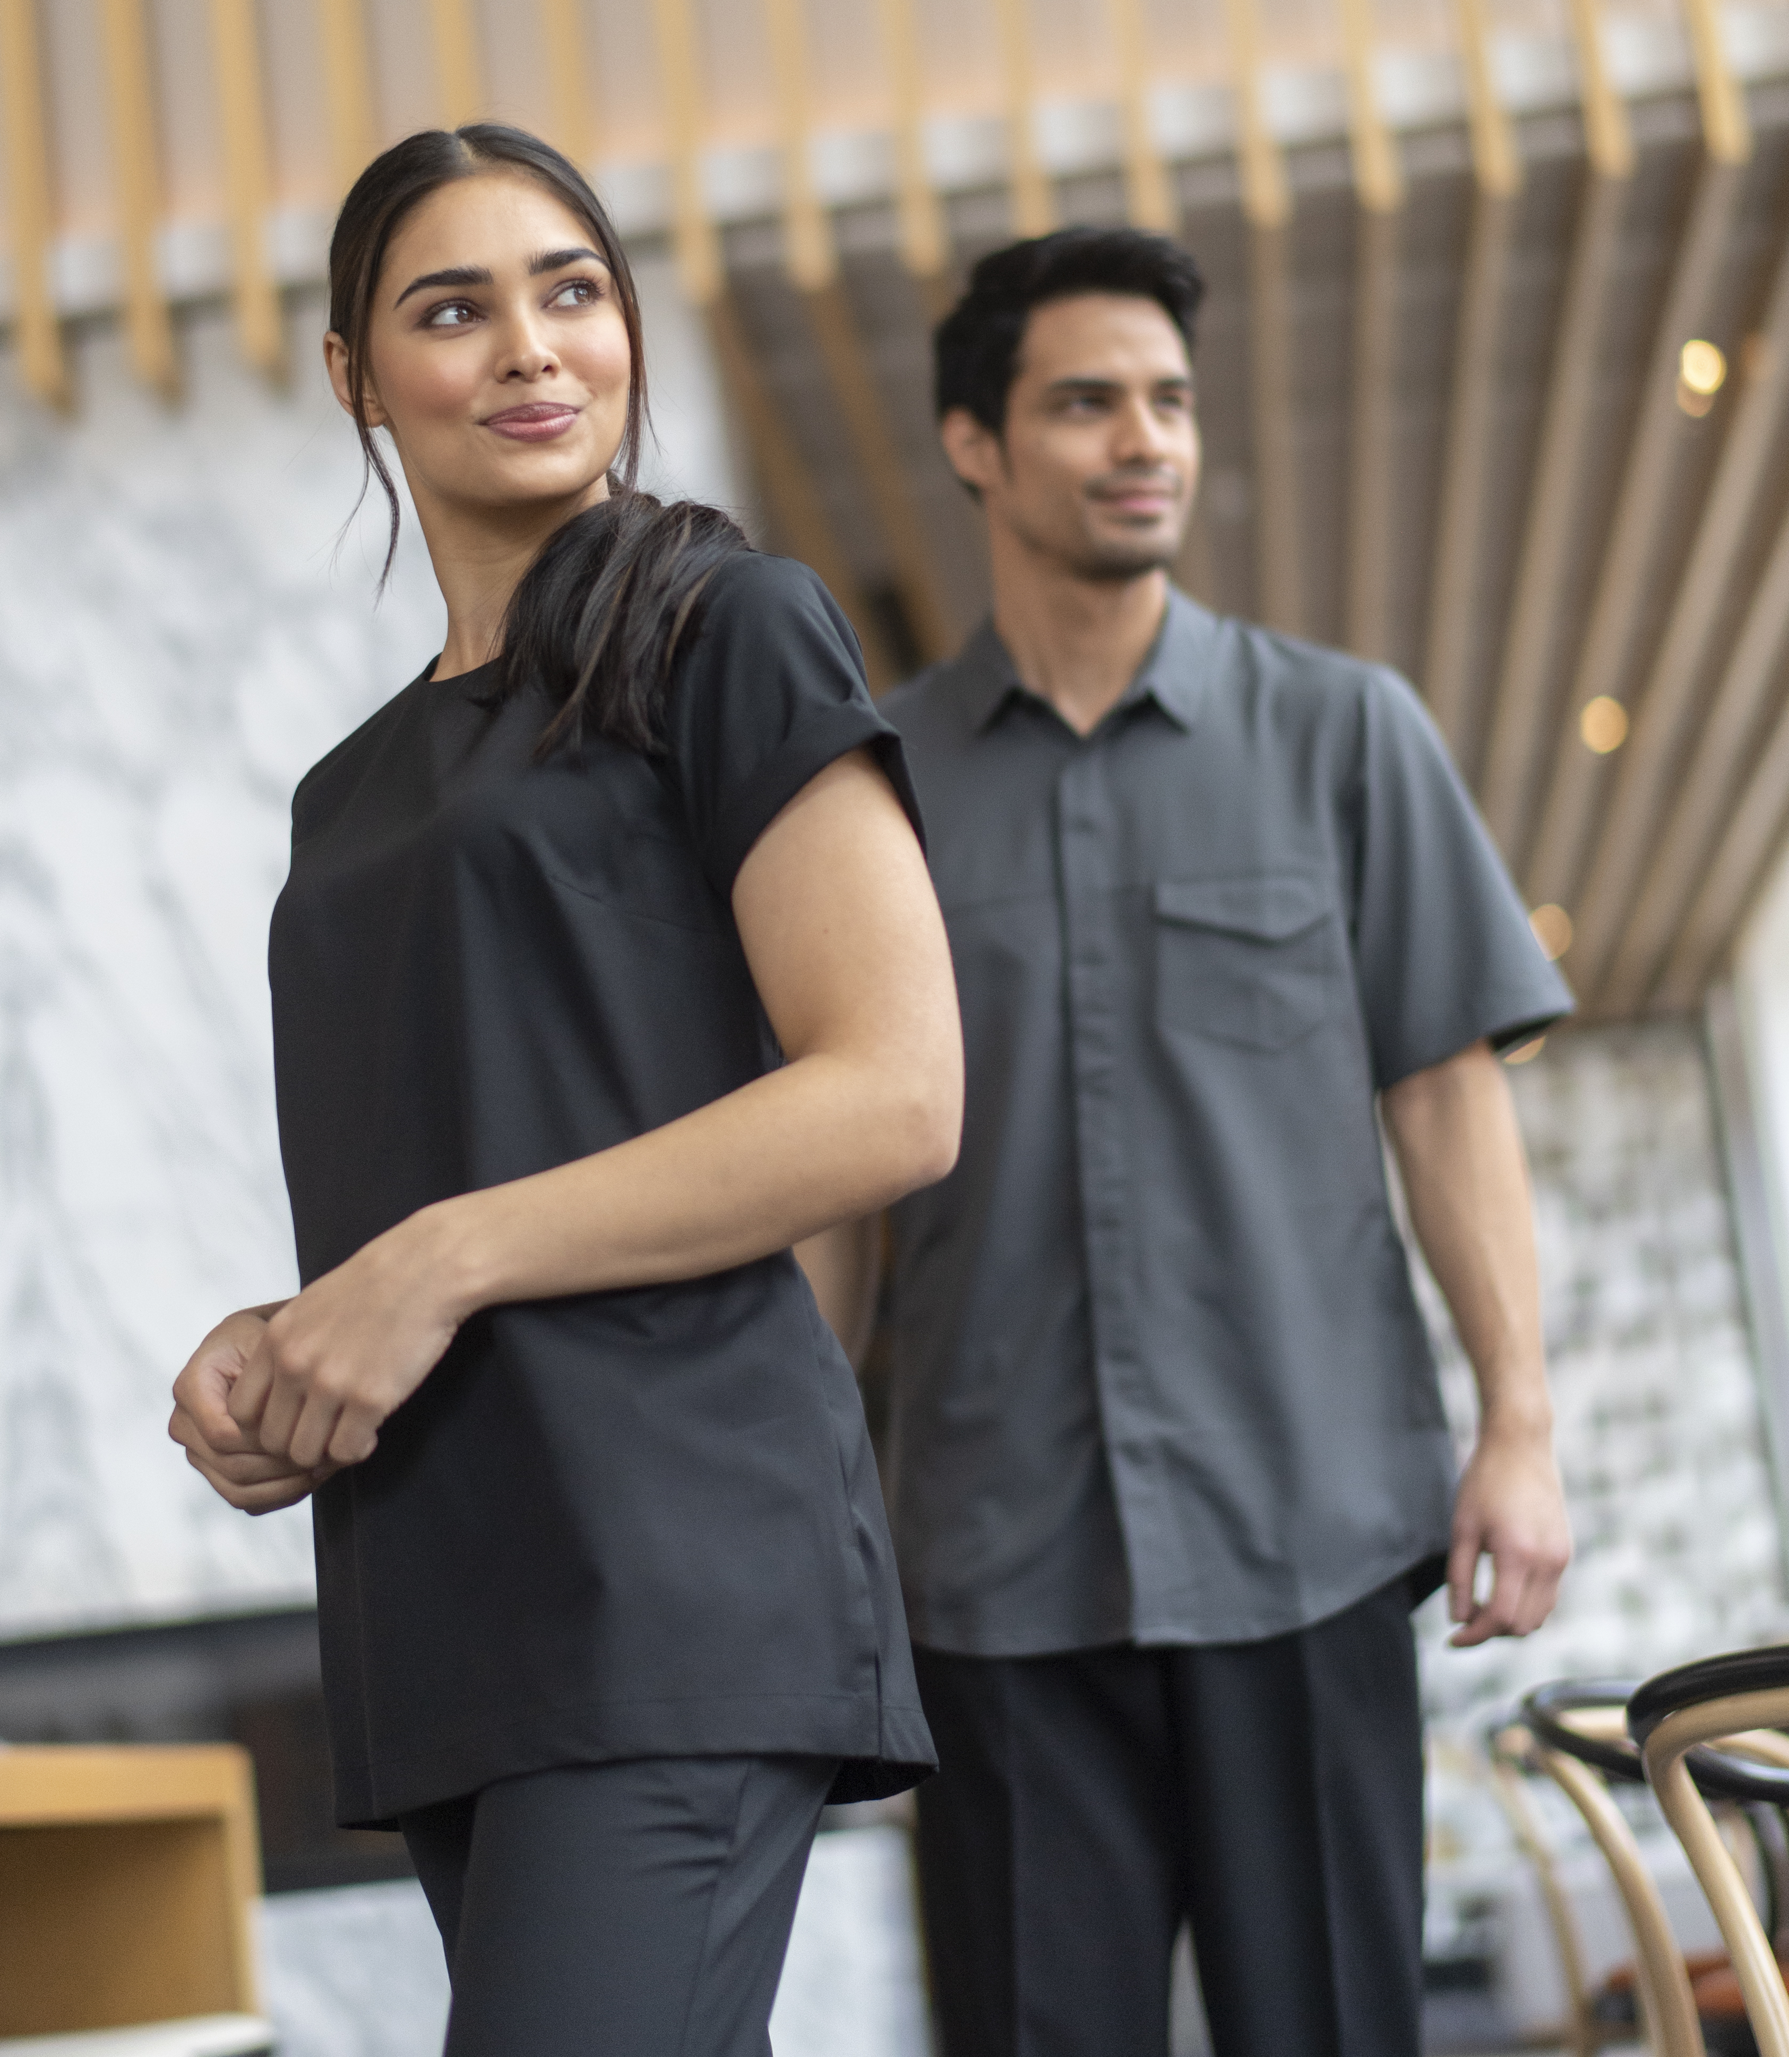
Housekeeping
Edwards Sorrento Shirt & Tunic #4283/7261/7283
Colors: Black, Steel Grey
Men’s Sizes: S-4XL | Ladies’ Sizes: XXS-4XL
Edwards Sorrento Housekeeping Pant #8861
Colors: Black, Steel Grey
Ladies’ Sizes: XXS-4XL
Edwards Microfiber Pant #2534/8532
Colors: Tan, Navy, Black
Men’s Sizes: 28-60 | Ladies’ Sizes: 00-32

Slide 13
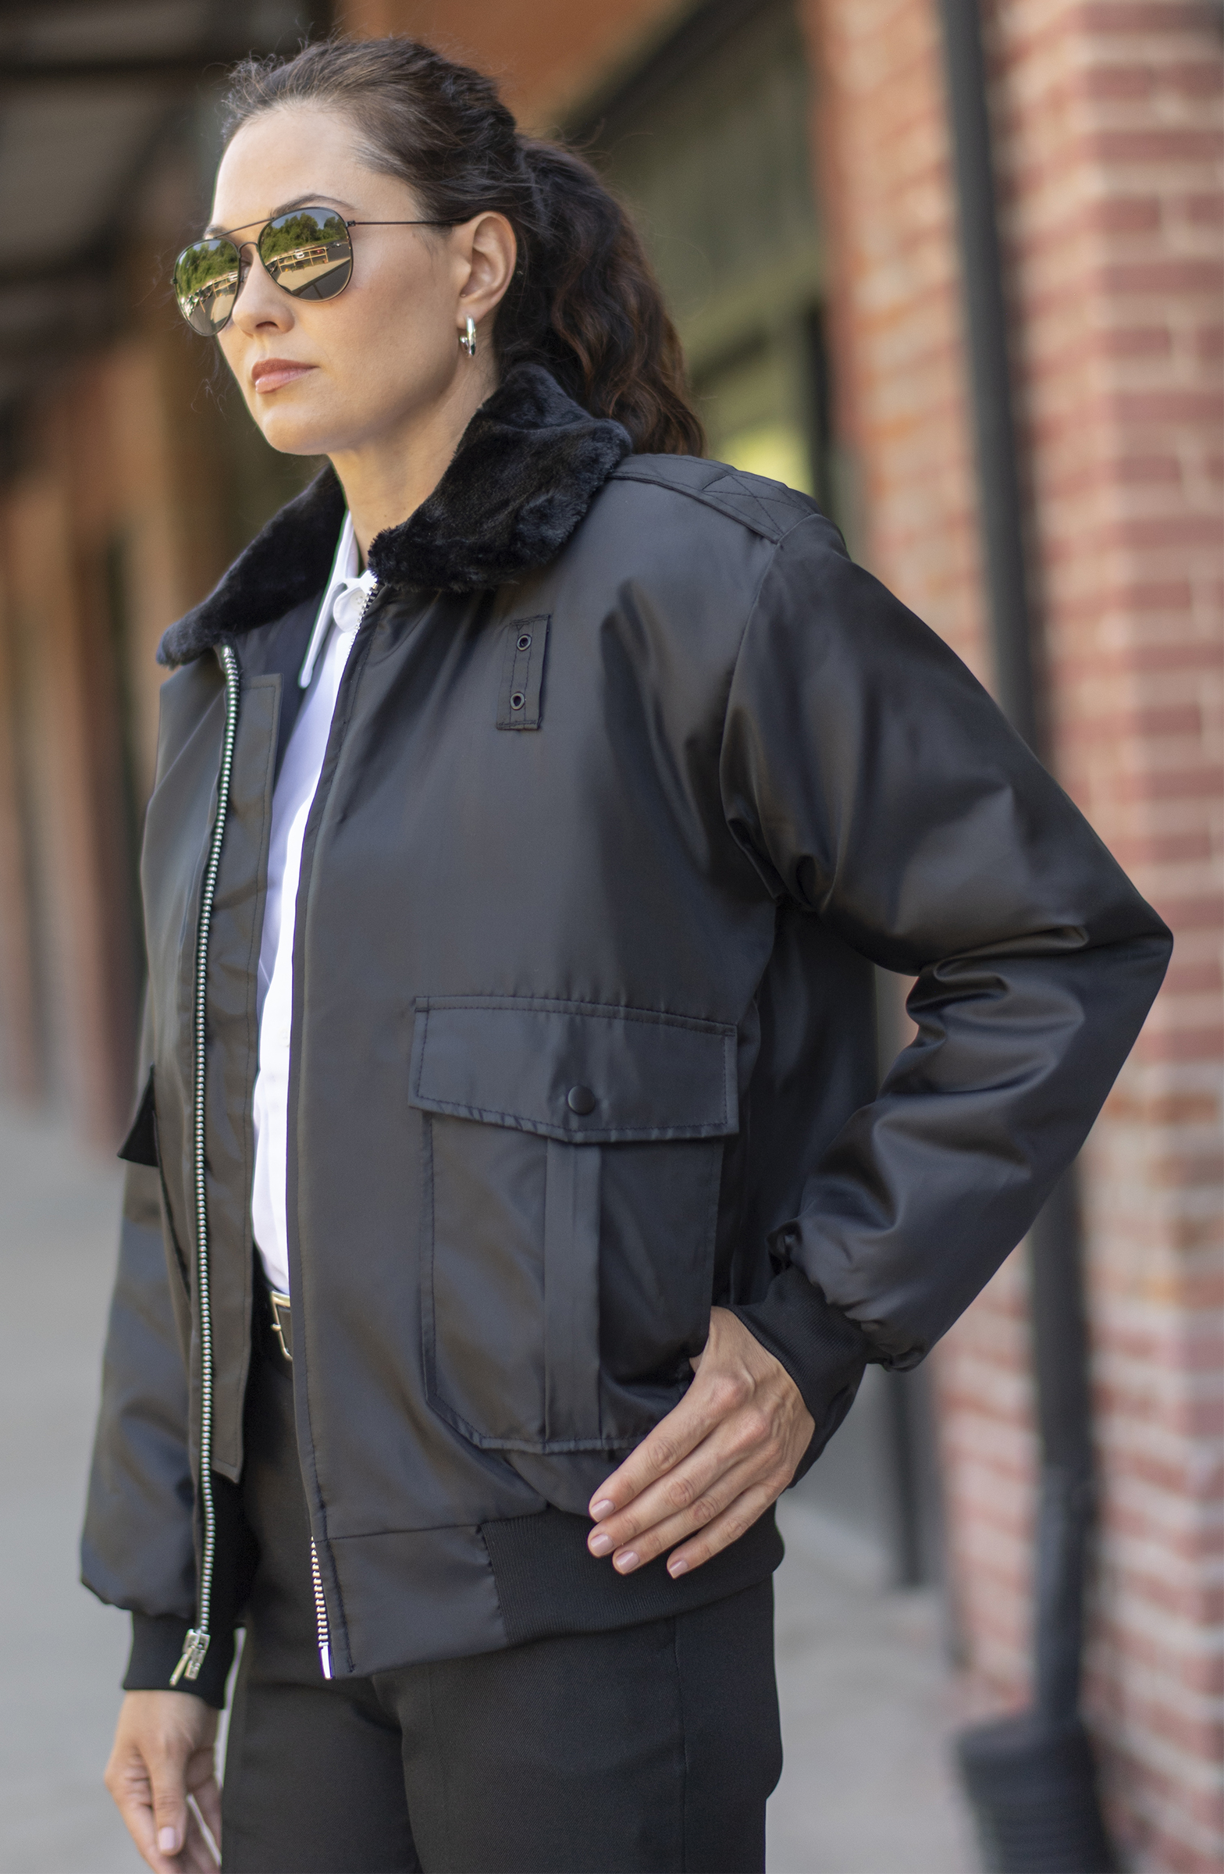
Security
Edwards Security Jacket #3462/3464
Colors: Black, Vulcan Navy
Unisex Sizes: XS-6XL, LT-3XLT
Edwards Security Shirt #1225/1275
Colors: White, Midnight, Nickle Grey, Silver Tan, Vulcan Navy, Medium Blue
Unisex Sizes: XS-3XL, LT-6XLT
Edwards EZ Fit Security Pant #2596/8596
Colors: Black, Vulcan Navy, Gunmetal Heather
Men’s Sizes: 28-64 | Ladies’ Sizes: 0-32
Edwards Clip-On Tie #CL00/CL22
Colors: Navy, Black
CL00: 20”L x 3-3/4”W | CL22: 22”L x 3-3/4”W

Slide 14
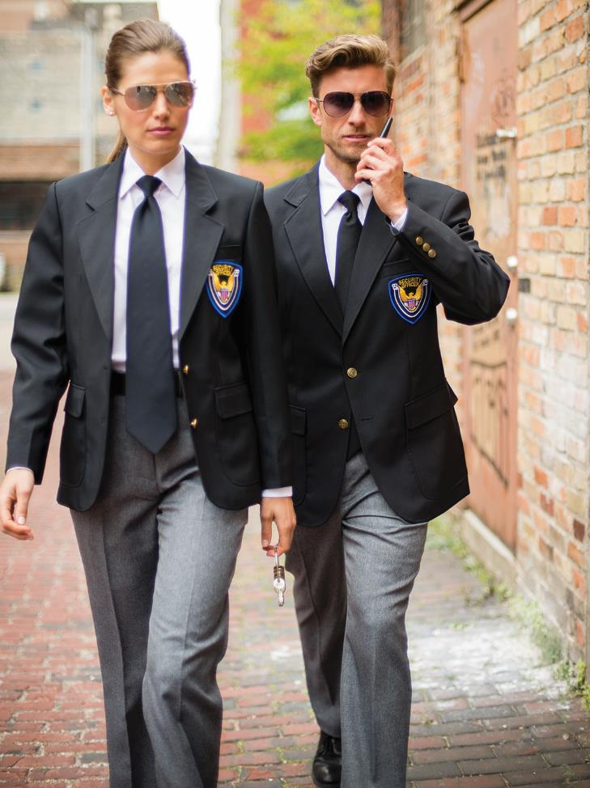
Security
Edwards Essential Polyester Blazer #3500/6500
Colors: Navy, Black, Red, Burgundy, Dark Navy
Men’s Sizes: 34-46S, 34-62R, 38-62L, 40-48XL | Ladies’ Sizes: 00-28
Edwards Security Shirt #1276
Color: White
Unisex Sizes: XS-3XL, LT-6XLT
Edwards Security Pant #2595/8591
Colors: Black, Dark Navy, Grey Heather
Men’s Sizes: 28-60 | Ladies’ Sizes: 0-18; 18W-28W
Edwards Clip-On Tie #CL00/CL22
Colors: Navy, Black
CL00: 20”L x 3-3/4”W | CL22: 22”L x 3-3/4”W

Slide 15
Maintenance
Edwards 3-Season Jacket #3410
Colors: Navy, Black, Navy/Charcoal, Black/Charcoal, Red/Charcoal, Royal/Charcoal, Forest/Charcoal
Unisex Sizes: XS-6XL, LT-3XLT
Edwards Chambray Shirt #1298/5298
Colors: Chambray Blue, Chambray Black
Men’s Sizes: S-3XL, MT-6XLT | Ladies’ Sizes: XXS-4XL
Edwards Utility Chino Cargo Pant #2538/8538
Colors: Tan, Navy, Black, Coal
Men’s Sizes: 28-60 | Ladies’ Sizes: 00-32

Slide 16
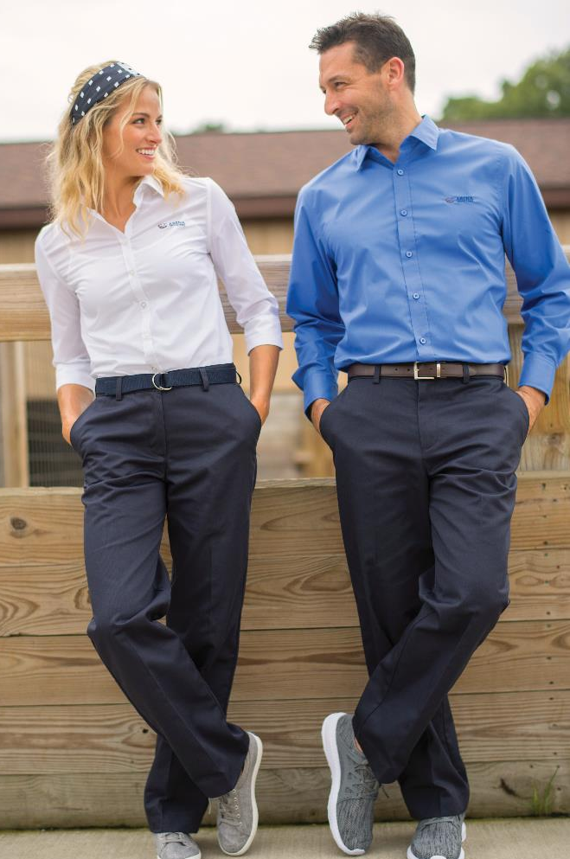
Maintenance
Edwards Essential Broadcloth #1314/1354/5354/5356
Colors: White, Blue, Navy, Black, French Blue
Men’s Sizes: S-3XL, MT-6XLT | Ladies’ Sizes: XXS-4XL
Edwards Mini-Pique Snag-Proof Polo #1507/1527/5507
Colors: White, Black, Red, Royal, French Blue, Steel Grey, Marina Blue, High Vis. Lime, High Vis. Orange, Bright Navy, Cool Grey
Men’s: S-3XL, 4XLT-6XLT | Ladies’: XXS-3XL | Unisex: XXS-3XL, 4XLT-6XLT
Edwards Utility Chino Pant #2537/8537
Colors: Tan, Navy, Black, Coal
Men’s Sizes: 28-60 | Ladies’ Sizes: 00-32

