Slide 1
CASINO & GAMING UNIFORMS

Slide 2
Guest Services – Floor Rep
Edwards Synergy Suit Coats #3525/6525/6575
Colors: Navy, Black, Steel Grey
Men’s Sizes: 34-46S, 34-62R, 38-62L
Ladies’ Sizes: 00-28
Edwards Synergy Dress Pants & Skirt #2525/2535/8525/8526/8535/9725/9745
Colors: Navy, Black, Steel Grey
Men’s Sizes: 28-60 | Ladies’ Sizes: 00-32
Edwards Pinpoint Oxfords #1978/5980
Colors: White, Light Blue, Charcoal, French Blue, Silver, Blue/White Stripe
Men’s Sizes: S-3XL, LT-6XLT | Ladies’ Sizes: XXS-4XL

Slide 3
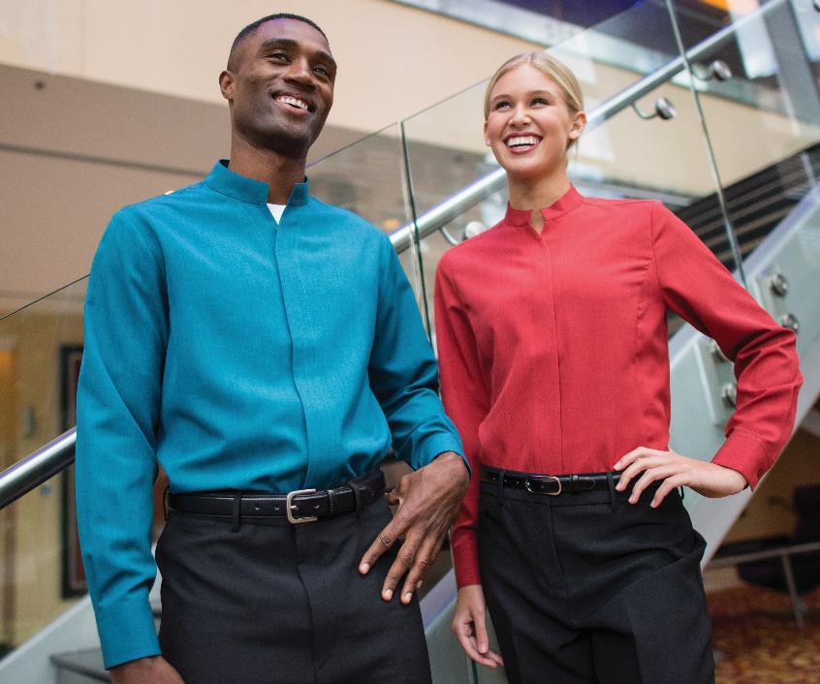
Guest Services – Floor Rep
Edwards Stand-Up Collar Batiste Shirts #1398/5398
Colors: Black, Red, Burgundy, Purple, Steel Grey, Riviera Blue, Caribbean Blue, Cobalt, Platinum
Men’s Sizes: S-3XL, LT-6XLT | Ladies’ Sizes: XXS-4XL
Edwards Essential No-Pocket Pant #2796/8794
Colors: Black
Men’s Sizes: 28-54 | Ladies’ Sizes: 0-32

Slide 4
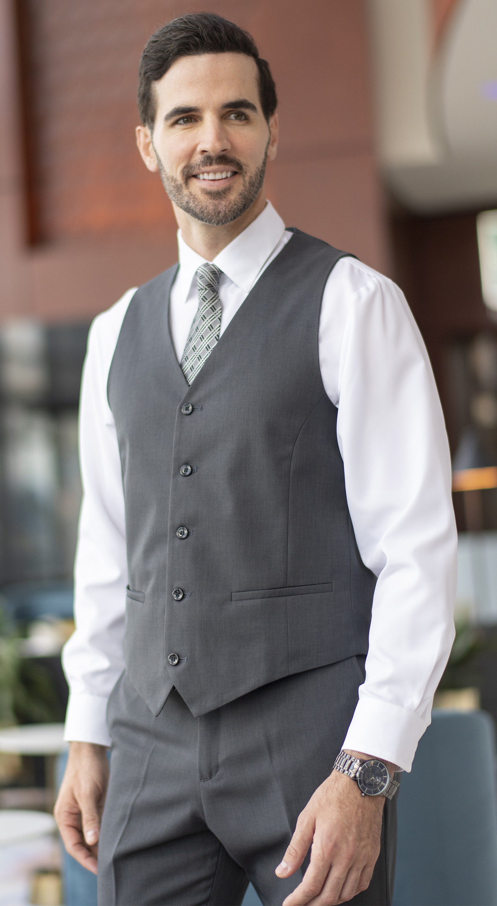
Guest Services – Cashier
Edwards Synergy Dress Vests #4525/7526
Colors: Navy, Black, Steel Grey
Men’s Sizes: S-4XL | Ladies’ Sizes: XS-3XL
Edwards Synergy Dress Pants & Skirt #2525/2535/8525/8526/8535/9725/9745
Colors: Navy, Black, Steel Grey
Men’s Sizes: 28-60 | Ladies’ Sizes: 00-32
Edwards Pinpoint Oxfords #1978/5980
Colors: White, Light Blue, Charcoal, French Blue, Silver, Blue/White Stripe
Men’s Sizes: S-3XL, LT-6XLT | Ladies’ Sizes: XXS-4XL

Slide 5
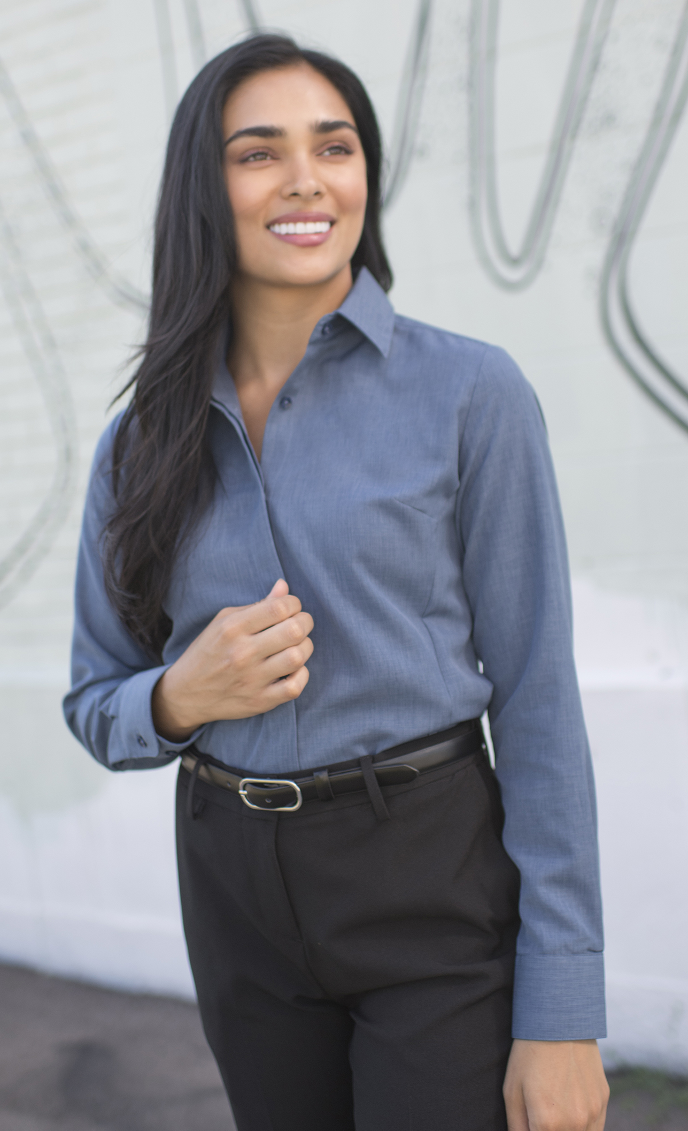
Guest Services – Cashier
Edwards Café Batiste Shirts #1291/5291
Colors: White, Black, Burgundy, Purple, Steel Grey, Riviera Blue, Caribbean Blue, Cobalt, Platinum
Men’s Sizes: S-3XL, LT-6XLT | Ladies’ Sizes: XXS-4XL
Edwards Essential No-Pocket Pant #2796/8794
Colors: Black
Men’s Sizes: 28-54 | Ladies’ Sizes: 0-32

Slide 6
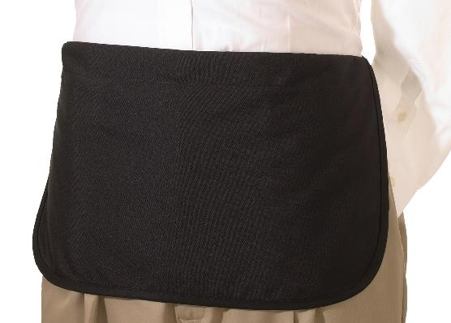
Dealers / Game Attendants
Edwards Stand-Up Collar Batiste Shirts #1398/5398
Colors: Black, Red, Burgundy, Purple, Steel Grey, Riviera Blue, Caribbean Blue, Cobalt, Platinum
Men’s Sizes: S-3XL, LT-6XLT | Ladies’ Sizes: XXS-4XL
Edwards Essential No-Pocket Pant #2796/8794
Colors: Black
Men’s Sizes: 28-54 | Ladies’ Sizes: 0-32
Edwards Casino Dealer Apron – No Pocket #9021
Colors: Black
Size: 11”L x 21”W

Slide 7
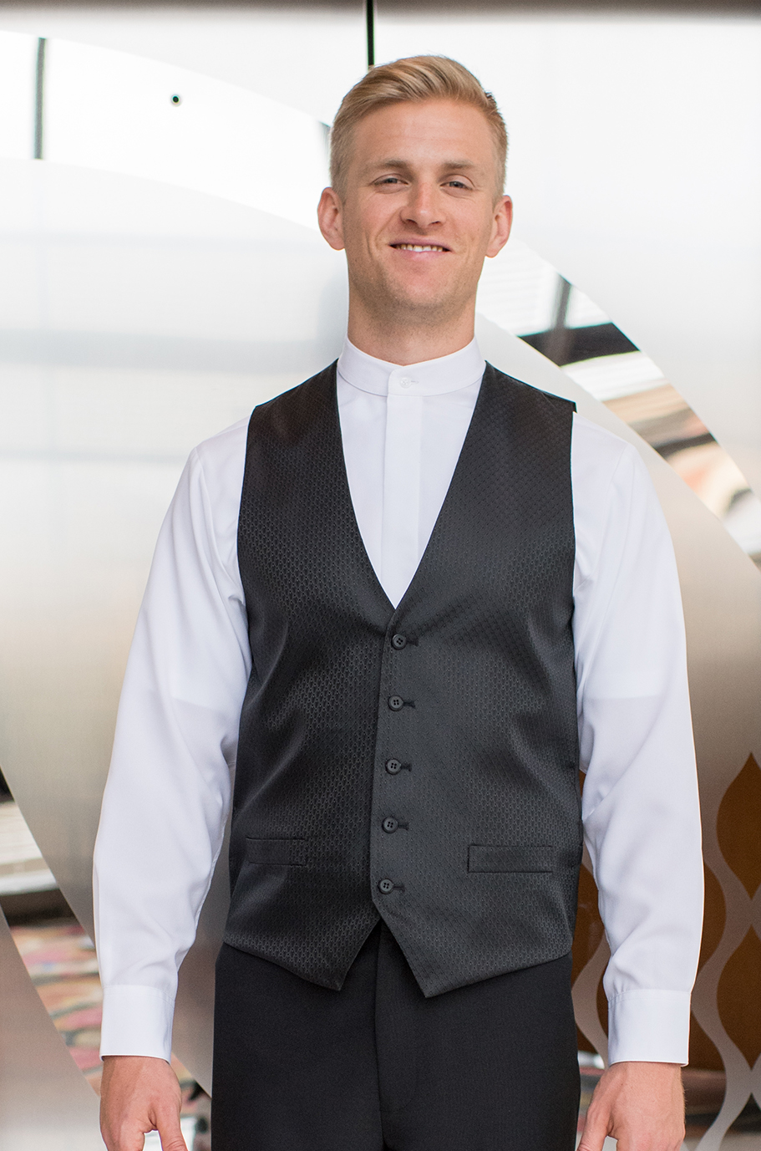
Dealers / Game Attendants
Edwards Diamond Brocade Vests #4390/7390
Colors: Black
Men’s Sizes: S-5XL | Ladies’ Sizes: XS-3XL
Edwards Essential No-Pocket Pant #2796/8794
Colors: Black
Men’s Sizes: 28-54 | Ladies’ Sizes: 0-32
Edwards Banded Collar Batiste Shirts #1392/5392
Colors: White, Black, Burgundy, Steel Grey, Riviera Blue
Men’s Sizes: S-3XL, LT-6XLT | Ladies’ Sizes: XXS-4XL

Slide 8
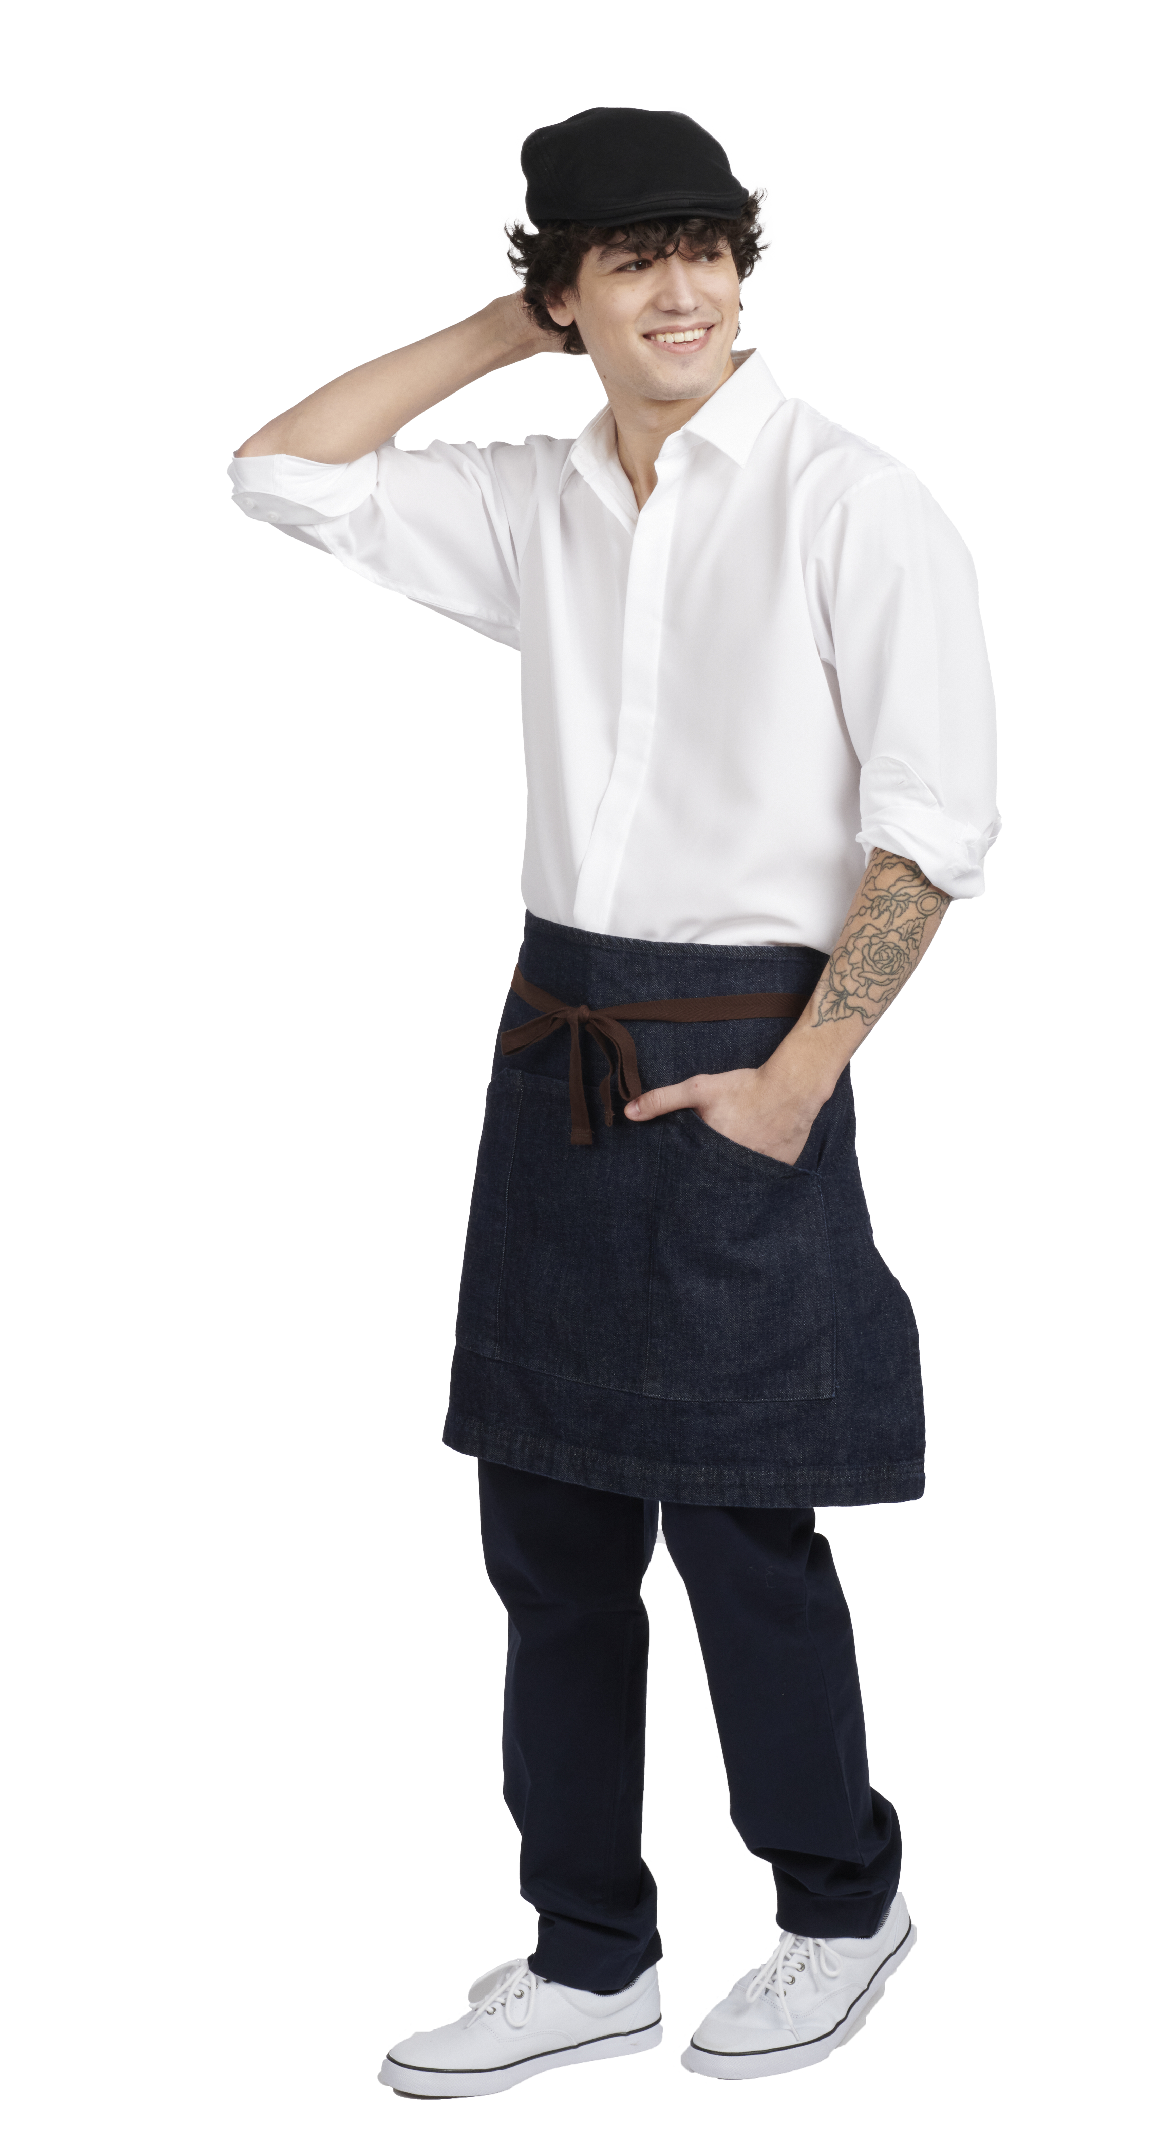
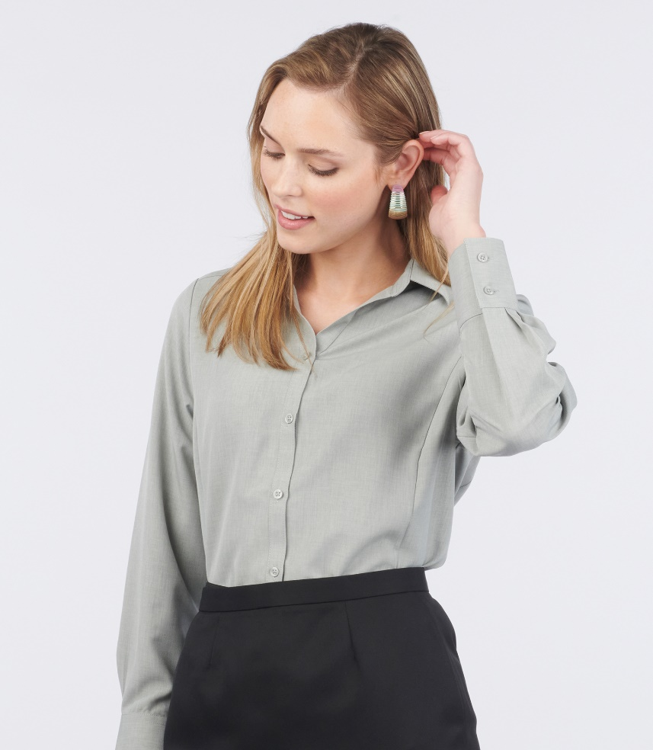
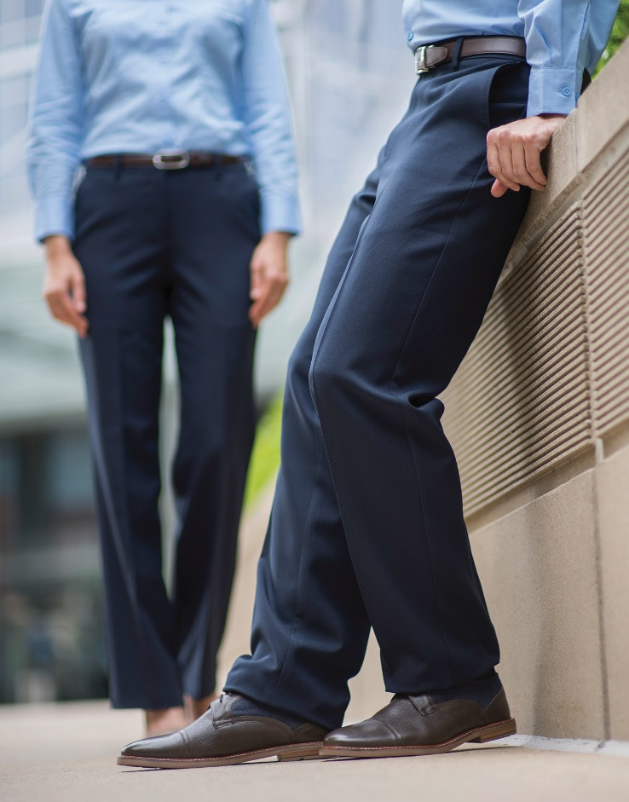
Beverage / Cocktail Servers
Edwards Batiste Dress Shirts #1292/5292/5293
Colors: White, Black, Steel Grey, Riviera Blue, Platinum
Men’s Sizes: S-3XL, LT-6XLT | Ladies’ Sizes: XXS-4XL
Edwards Essential Easy Fit Pants #2793/8793
Colors: Black, Dark Navy, Steel Grey, Cobblestone
Men’s Sizes: 28-60 | Ladies’ Sizes: 00-32
Edwards Herringbone Tie #HB00/HB60
Colors: Blue, Navy, Black, Wine, Maize, Titanium
Tie: 58”L x 3-3/4”W | Neckerchief: One Size
Edwards Denim Waist Apron #9098
Colors: Black Denim, Indigo Denim
Measurements: 19”L x 28”W | One Size Fits Most

Slide 9
Beverage / Cocktail Servers
Edwards Batiste Service Shirt #1031
Colors: Black, Burgundy, Steel Grey, Riviera Blue, Platinum
Unisex Sizes: XXS-6XL
Edwards Café Broadcloth Shirt #1290/5290
Colors: White, Black, Royal
Men’s Sizes: S-3XL, LT-6XLT | Ladies’ Sizes: XXS-3XL
Edwards Microfiber Pants #2534/8532
Colors: Tan, Navy, Black
Men’s Sizes: 28-60 | Ladies’ Sizes: 00-32

Slide 10
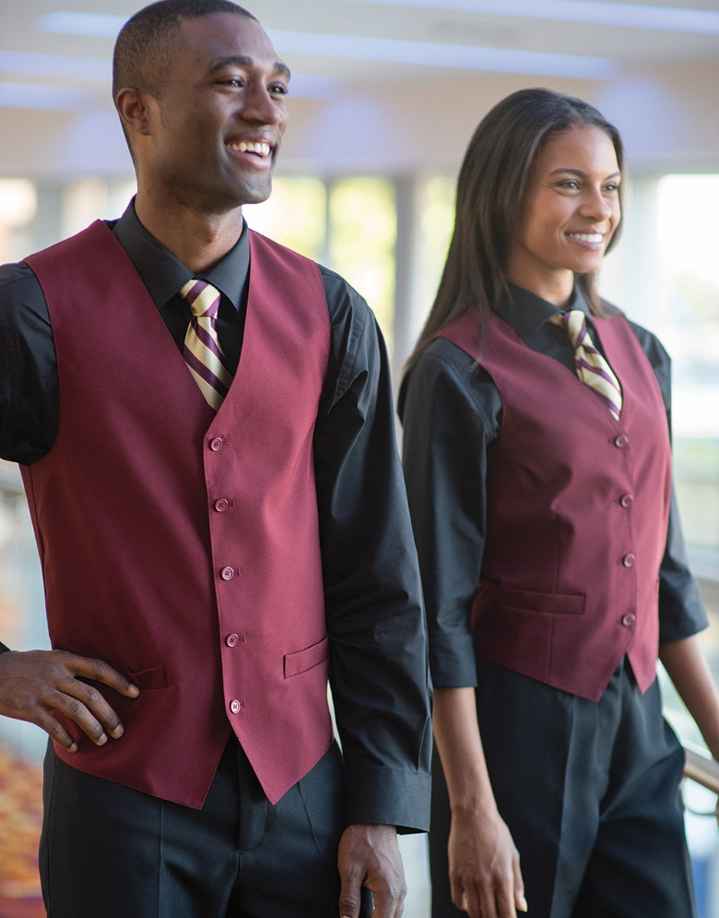
Restaurant
Edwards Hospitality Vest #4490/7490
Colors: Navy, Black, Red, Burgundy, Dark Navy
Men’s Sizes: S-5XL | Ladies’ Sizes: XS-3XL
Edwards Essential Easy Fit Pants #2793/8793
Colors: Black, Dark Navy, Steel Grey, Cobblestone
Men’s Sizes: 28-60 | Ladies’ Sizes: 00-32
Edwards Café Batiste Shirts #1291/5291
Colors: White, Black, Burgundy, Purple, Steel Grey, Riviera Blue, Caribbean Blue, Cobalt, Platinum
Men’s Sizes: S-3XL, LT-6XLT | Ladies’ Sizes: XXS-4XL

Slide 11
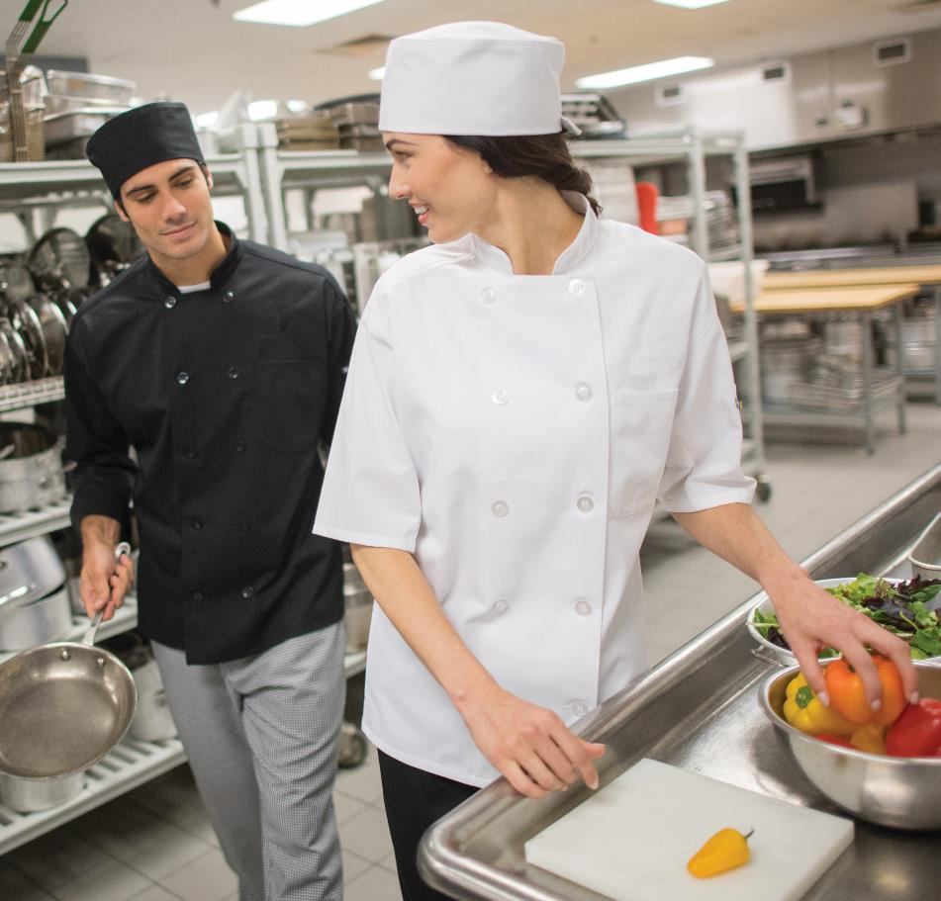
Culinary
Edwards Mesh Back Chef Coat (Short-Sleeve) #3333
Colors: White, Black
Unisex Sizes: XS-6XL
Edwards Mesh Back Chef Coat (Long-Sleeve) #3363
Colors: White, Black
Unisex Sizes: XS-6XL
Edwards Traditional Chef Pant #2001
Colors: Black
Unisex Sizes: XS-6XL
Edwards Beanie with Elastic Back #HT02
Colors: White, Black
Size: One Size Fits Most

Slide 12
Culinary
Edwards Cook Shirt with Mesh Back #1305
Colors: Black
Unisex Sizes: XS-6XL
Edwards Bistro Shirt #1350
Colors: Black
Unisex Sizes: XS-6XL
Edwards Cargo Chef Pant #2003
Colors: Black
Unisex Sizes: XS-6XL
Edwards Long Bistro Apron with 2 Pockets #9012
Colors: Black
Size: 33”L x 28”W

Slide 13
Valet / Parking
Edwards AIRGRIDTM Snag-Proof Polos #1579/5579
Colors: Black, Steel Grey, Bright Navy, Cool Grey
Men’s Sizes: S-3XL, 4XLT-6XLT | Ladies’ Sizes: XXS-4XL
Edwards Comfort Stretch Slim Chino Pants #2555/8555
Colors: Tan, Black, Dark Navy, Steel Grey
Men’s Sizes: 28-42 | Ladies’ Sizes: 0-20
Edwards Coach’s Jacket #3430
Colors: Yellow, Navy, Black, Red, Royal
Unisex Sizes: XXS-6XL

Slide 14
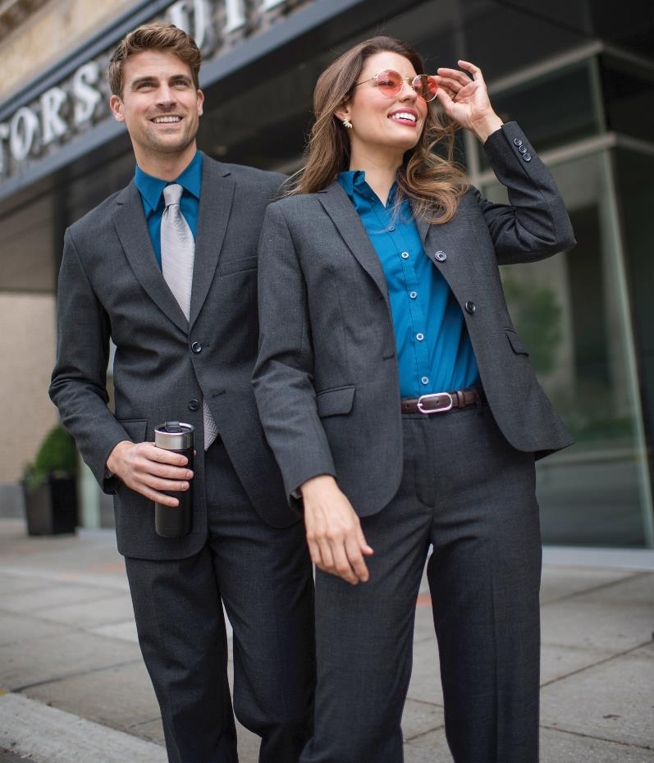
Security
Edwards Signature Suit Coats #3633/3650/6633
Colors: Navy, Black, Charcoal
Men’s Sizes: 34-46S, 34-62R, 38-62L | Ladies’ Sizes: 0-32
Edwards Signature Dress Pants & Skirt #2633/2733/8733/9733
Colors: Navy, Black, Charcoal
Men’s Sizes: 28-54 | Ladies’ Sizes: 0-32
Edwards Pinpoint Oxford #1975/5975
Colors: White, Blue, Dark Grey, French Blue
Men’s Sizes: S-3XL, LT-6XLT | Ladies’ Sizes: XXS-3XL

Slide 15
Security
Edwards Security Bomber Jacket #3462/3464
Colors: Black, Vulcan Navy
Unisex Sizes: XS-6XL, LT-3XLT
Edwards EZ Fit Security Pants #2596/8596
Colors: Black, Vulcan Navy, Gunmetal Heather
Men’s Sizes: 28-64 | Ladies’ Sizes: 0-32
Edwards Security Shirts #1225/1275
Colors: White, Blue, Midnight Navy, Nickel Grey, Silver Tan, Vulcan Navy, Medium Blue
Unisex Sizes: XS-3XL, LT-6XLT

Slide 16
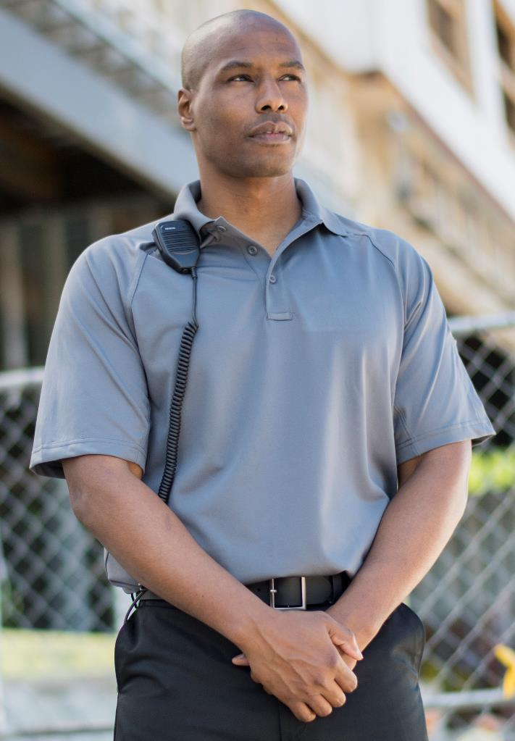
Security
Edwards Tactical Snag-Proof Polos #1517/1567
Colors: White, Navy, Black, Royal, Steel Grey, Silver Tan
Men’s Sizes: S-3XL, LT-6XLT | Ladies’ Sizes: XXS-4XL | Unisex Sizes: XXS-6XL
Edwards Security Pants #2595/8591
Colors: Black, Dark Navy, Grey Heather
Men’s Sizes: 28-60 | Ladies’ Sizes: 0-18, 18W-28W

Slide 17
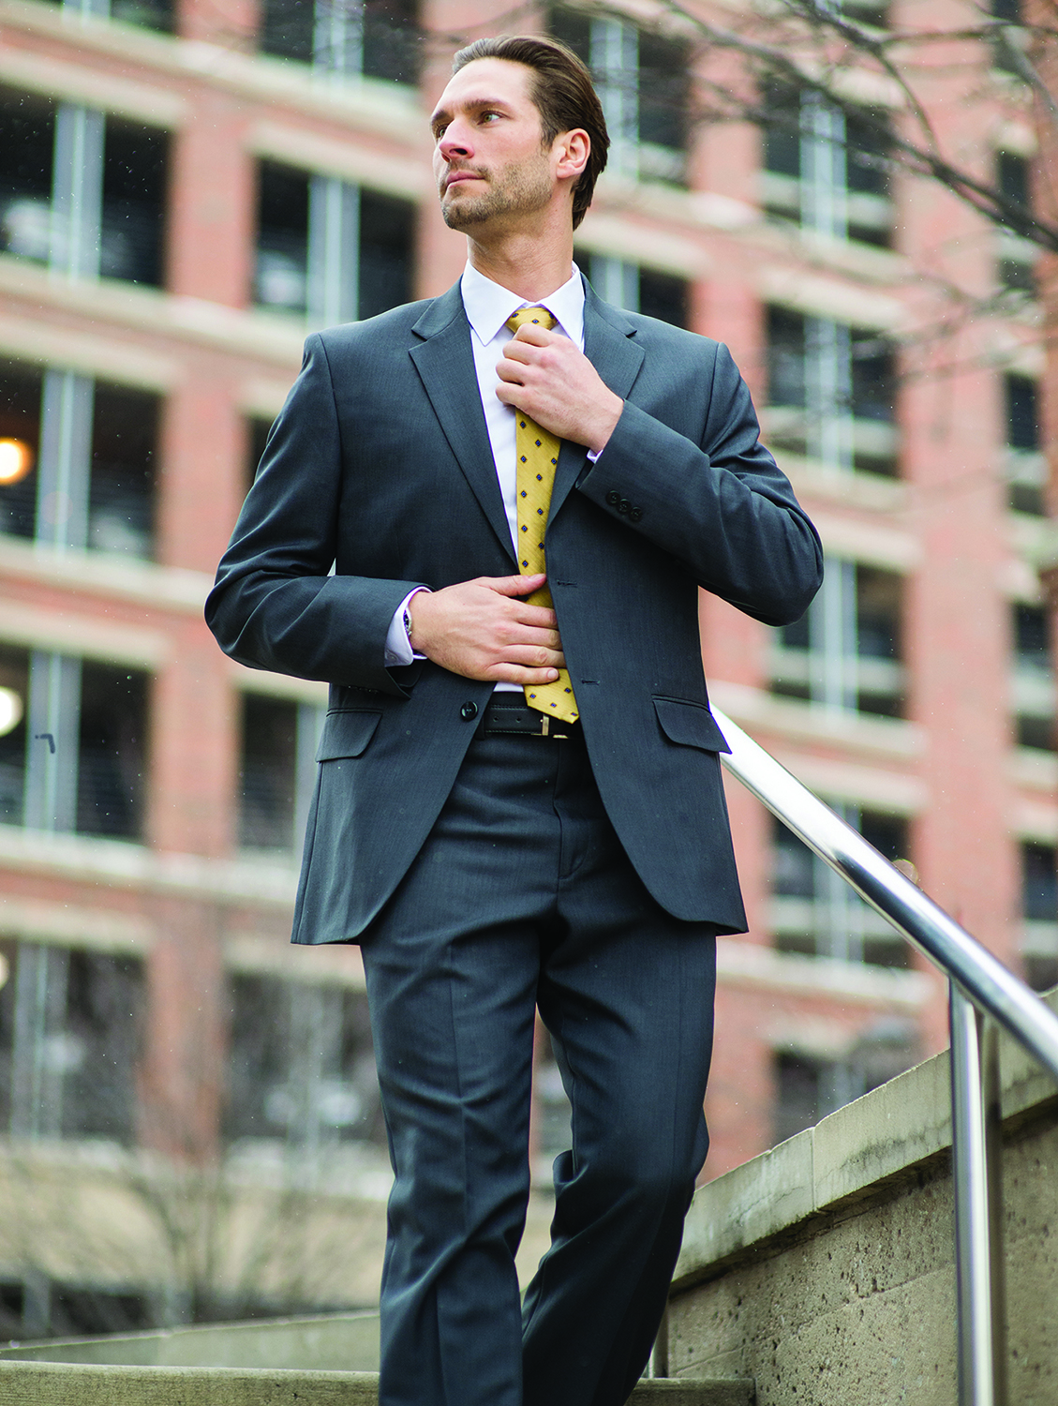
Management
Edwards Synergy Suit Coats #3525/6525/6575
Colors: Navy, Black, Steel Grey
Men’s Sizes: 34-46S, 34-62R, 38-62L
Ladies’ Sizes: 00-28
Edwards Synergy Dress Pants & Skirt #2525/2535/8525/8526/8535/9725/9745
Colors: Navy, Black, Steel Grey
Men’s Sizes: 28-60 | Ladies’ Sizes: 00-32
Edwards Pinpoint Oxfords #1978/5980
Colors: White, Light Blue, Charcoal, French Blue, Silver, Blue/White Stripe
Men’s Sizes: S-3XL, LT-6XLT | Ladies’ Sizes: XXS-4XL

Slide 18
Management
Edwards Russel Suit Coats #3530/6530/6535
Colors: Navy Agate, Black Onyx, Charcoal Marl
Men’s Sizes: 34-46S, 36-58R, 36-58L | Ladies’ Sizes: 0-32R, 4-18T
Edwards Russel Dress Pants & Skirt #2530/8530/9730
Colors: Navy Agate, Black Onyx, Charcoal Marl
Men’s Sizes: 28-54 | Ladies’ Sizes: 0-32
Edwards Stretch Broadcloths #1033/5033
Colors: White, Black, French Blue
Men’s Sizes: S-3XL, MT-6XLT | Ladies’ Sizes: XXS-4XL

